Slide 1
Practicals single block analyses

Slide 2
Context and dataset introduction
library(CCA)
data("nutrimouse")
The dataset comes from a nutrigenomic study in the mouse (Martin et al., 2007, https://doi.org/10.1002/hep.21510) in which the effects of five regimens with contrasted fatty acid compositions on liver lipids and hepatic gene expression in mice were considered.
Objective: Investigate the impact of five diets with distinct fatty acid profiles on liver lipids and gene expression.
Design: 40 mice, cross-classified by:
Genotype: WT vs PPARα -/-
Diet: corn and colza oils (50/50) for a reference diet (REF), hydrogenated coconut oil for a saturated fatty acid diet (COC), sunflower oil for an Omega6 fatty acid-rich diet (SUN), linseed oil for an Omega3-rich diet (LIN) and corn/colza/enriched fish oils for the FISH diet (43/43/14)
Variables:
Gene expression: 120 selected genes (among about 30,000) as potentially relevant in the context of the nutrition study (macroarray)
Lipid composition: 21 hepatic fatty acids (GC analysis)

Slide 3
Single Block Analysis – PCA
Goals
Explore structure and variability in each block (genes and lipids)
Tasks
1. Data exploration
Visualize distributions
Check normalisation
2. Principal Component Analysis (PCA)
Compute PCA for genes and lipids
Plot scree plots (explained variance)
3. Sample space visualization
Plot scores: Dim.1 vs Dim.2 and Dim.3 vs Dim.4
Identify main sources of variation
4. Variable contributions
Plot loadings: Dim.1 vs Dim.2 and Dim.3 vs Dim.4
Interpret biological relevance
library(ropls)
opls()
PCA_res@pcaVarVn
PCA_res@scoreMN
PCA_res@loadingsMN

Slide 4
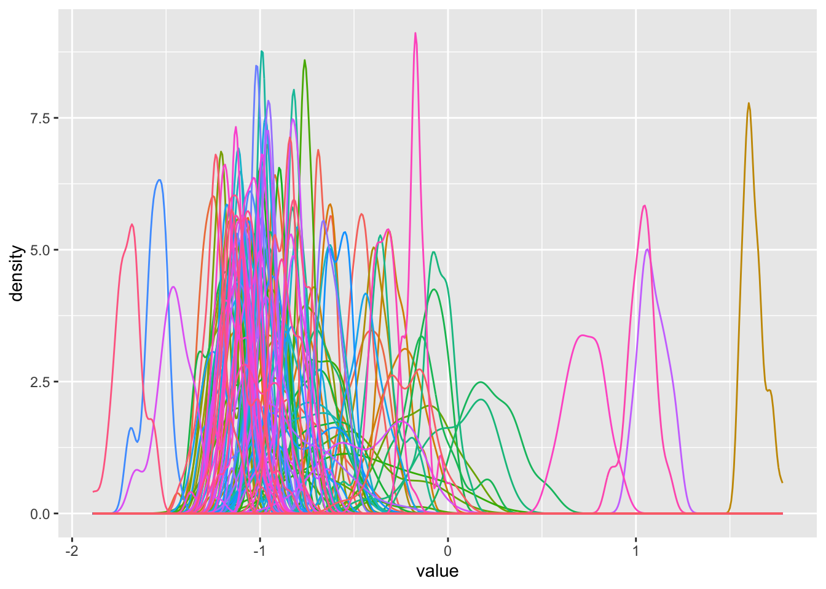
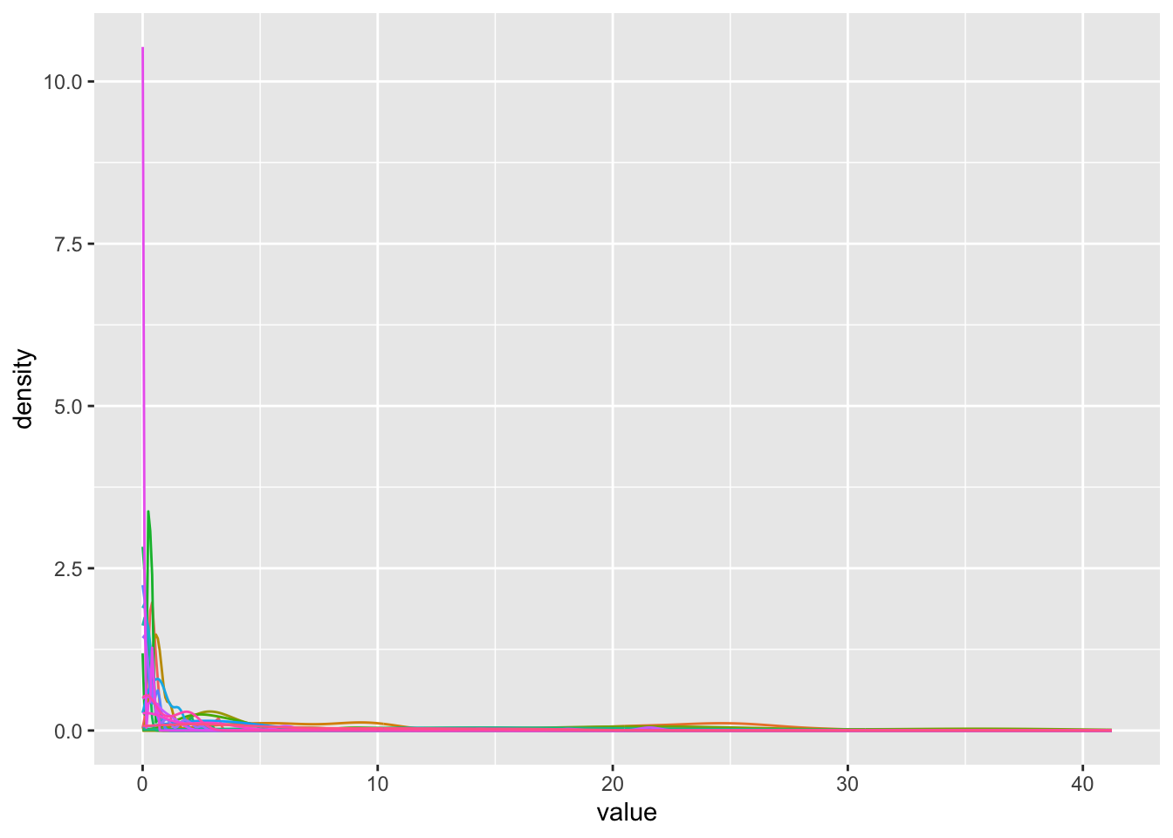
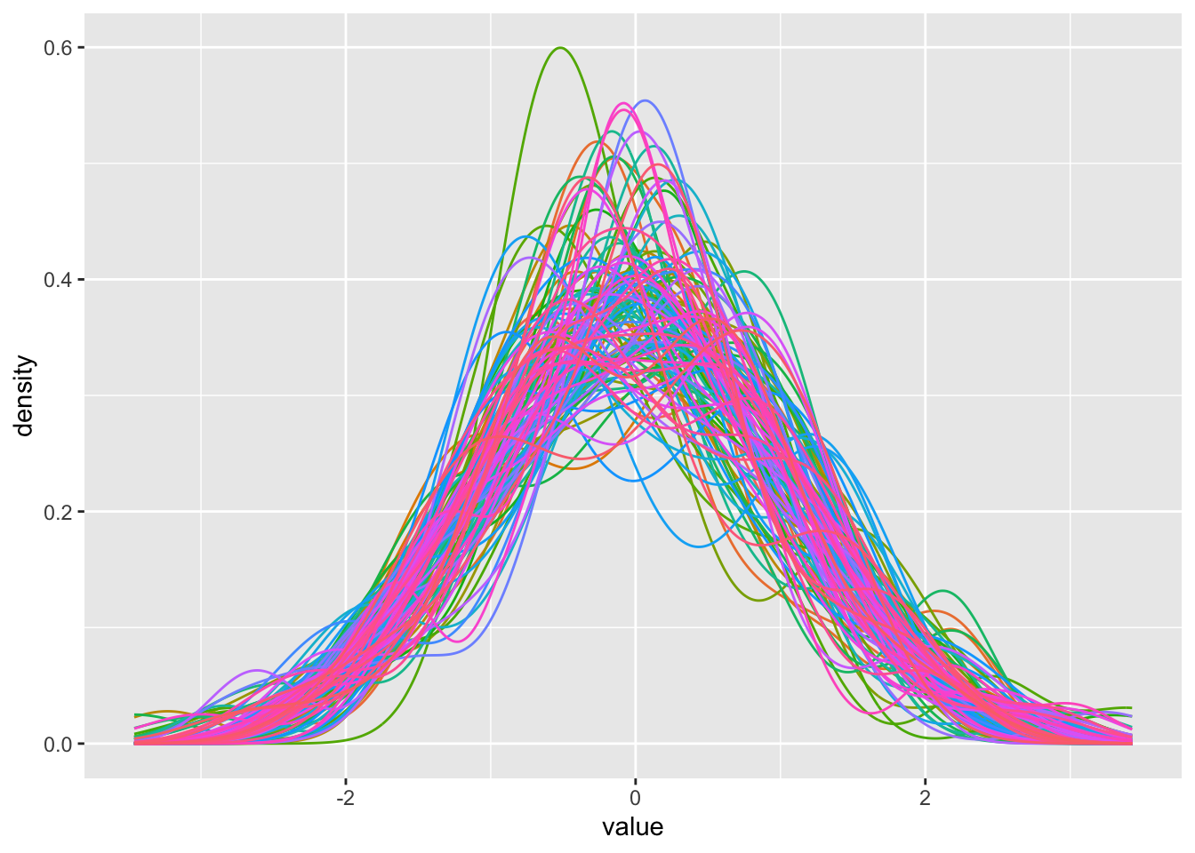
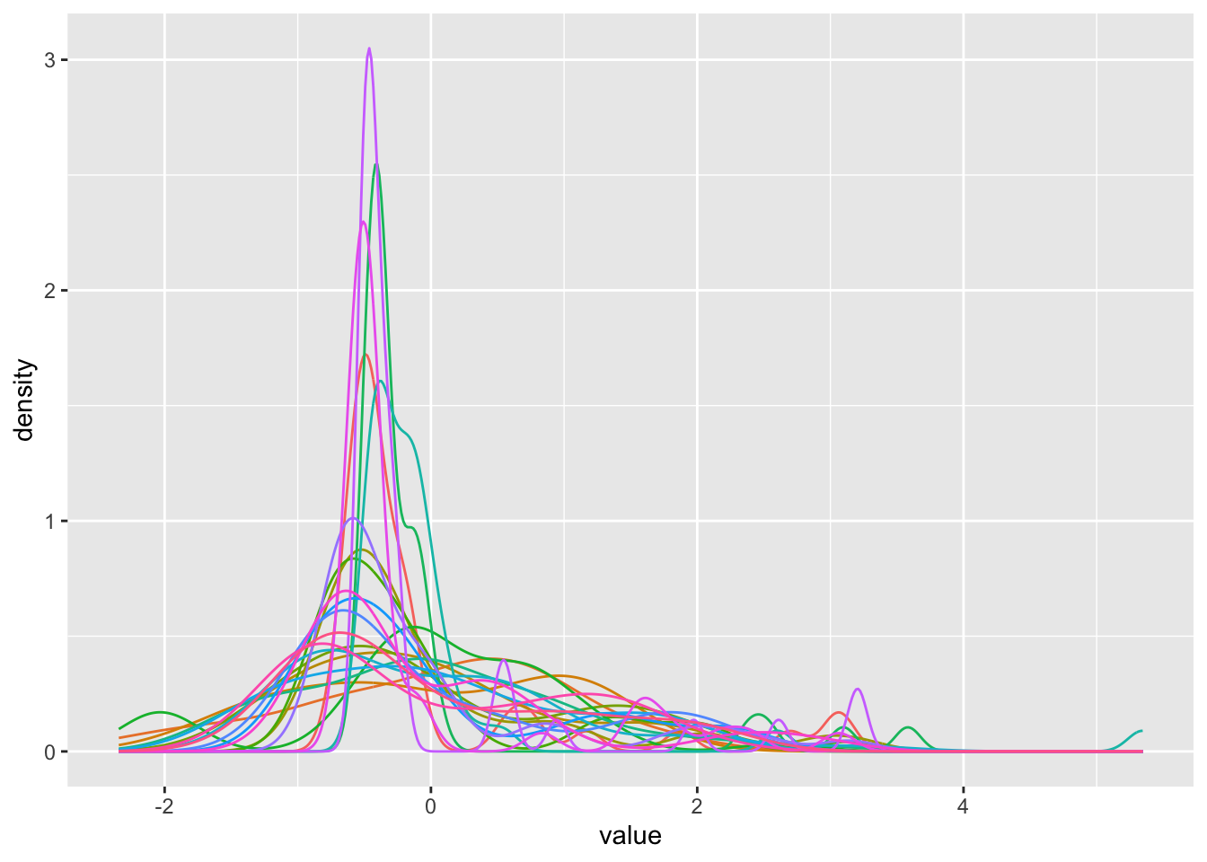
Data distribution
genes
lipids
scaling
scaling

Slide 5
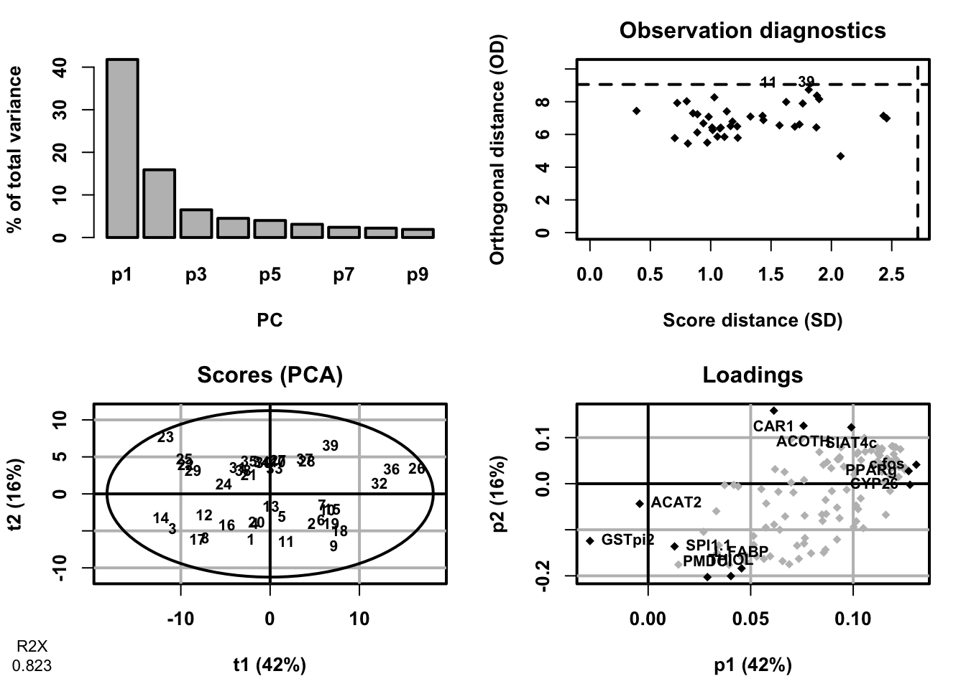
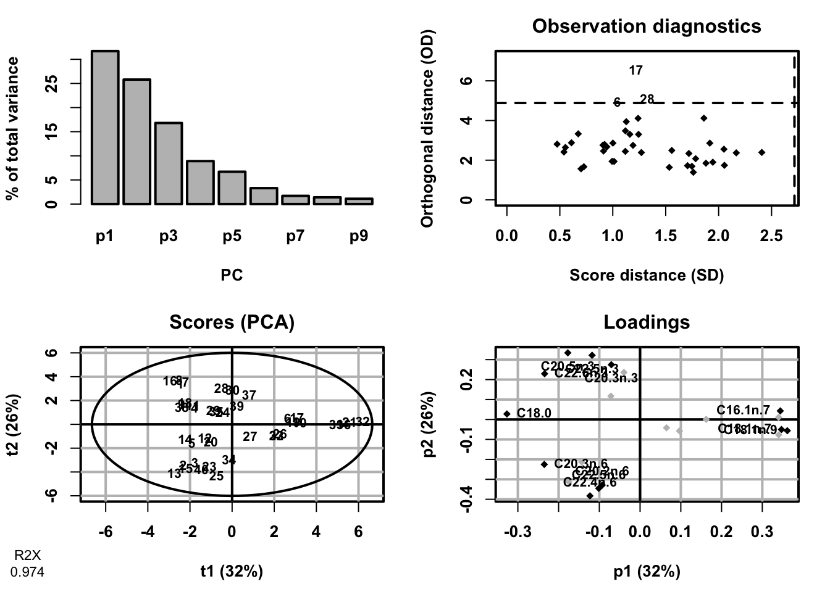
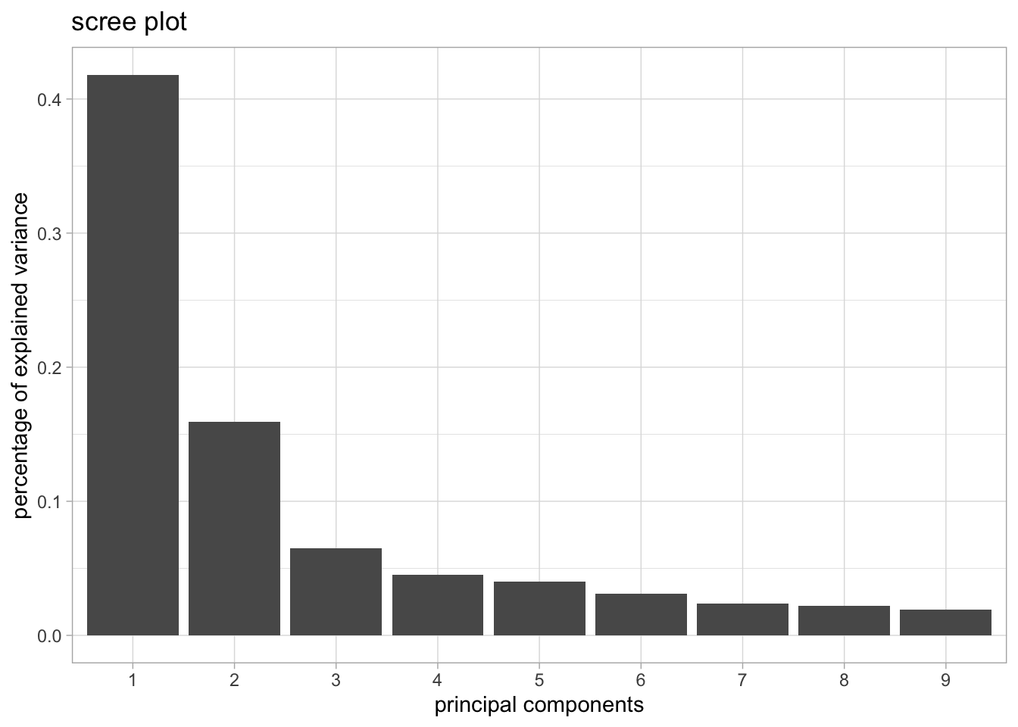
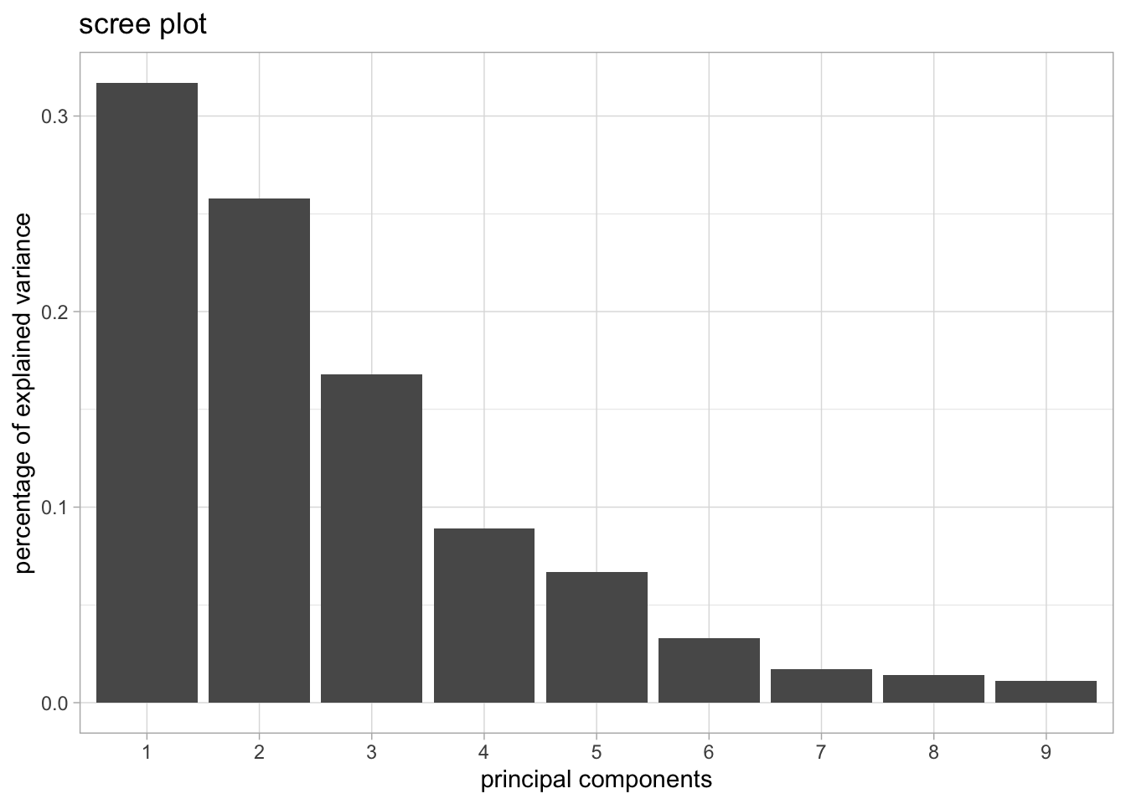
PCA models
genes
lipids

Slide 6
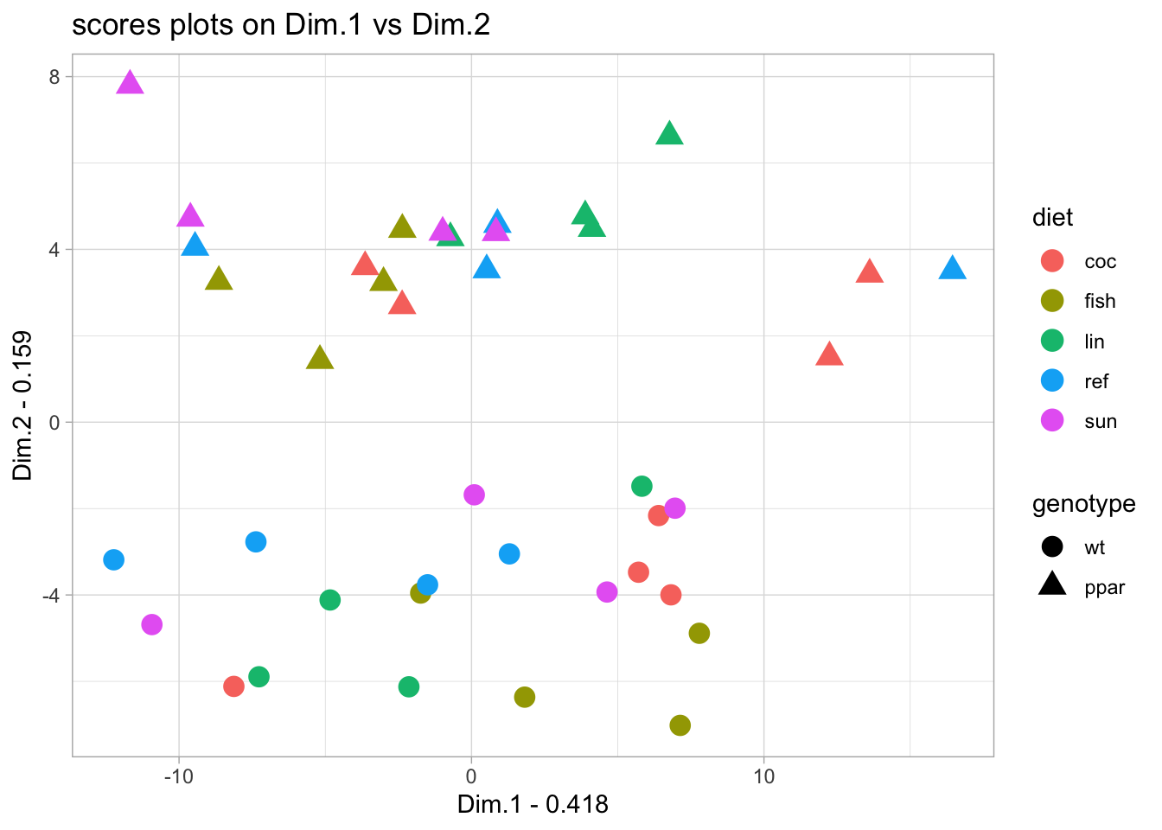
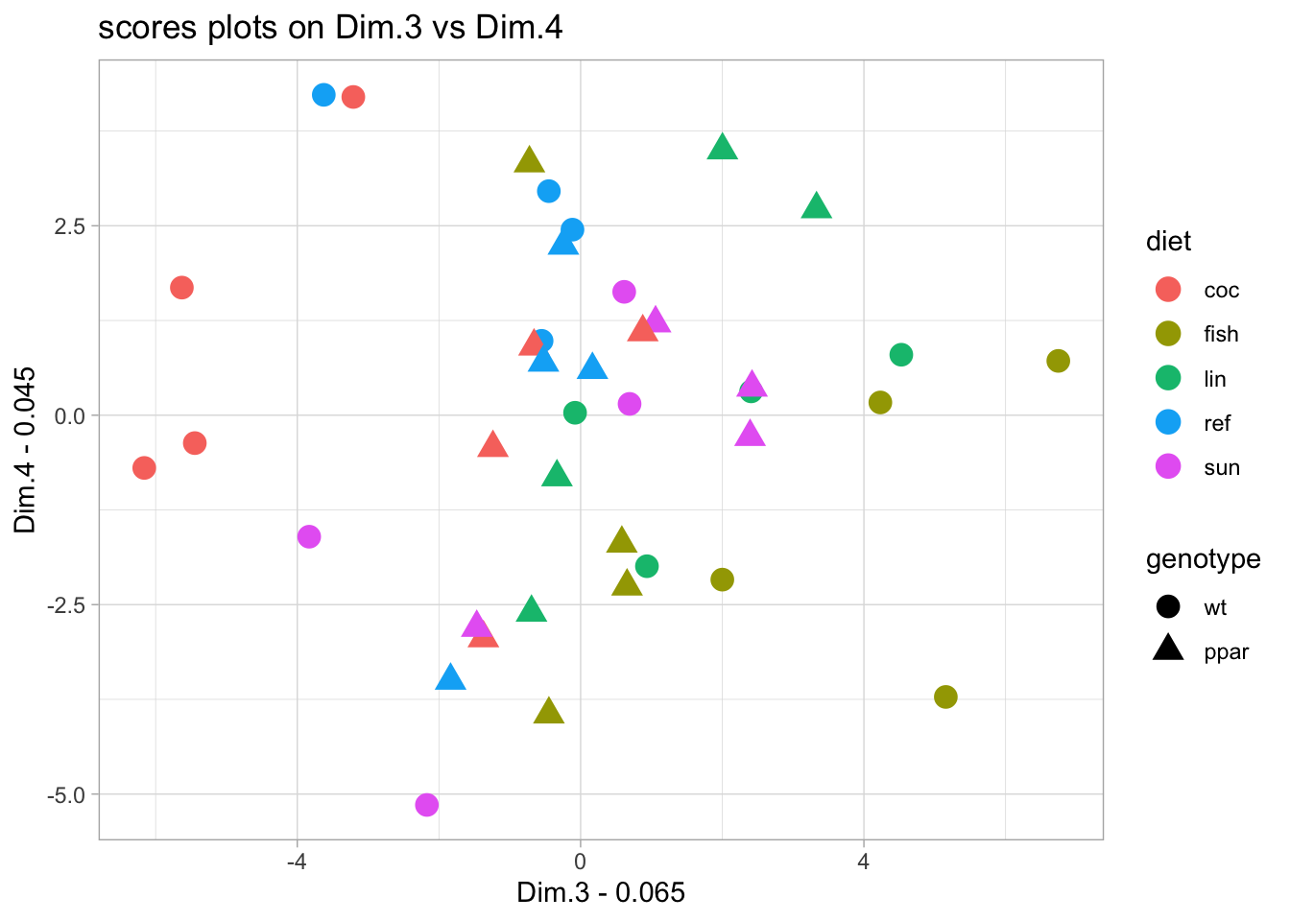
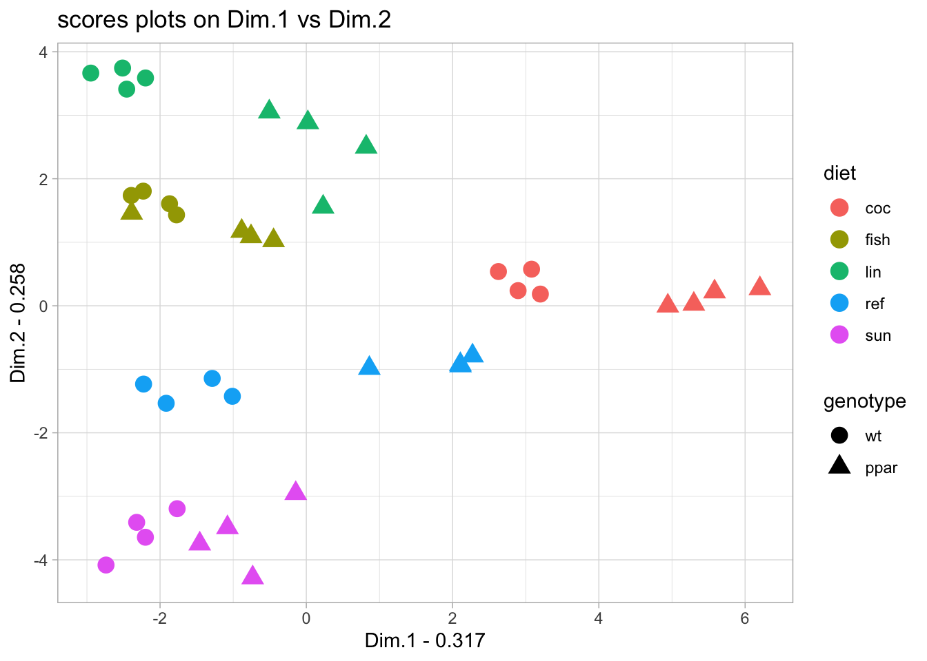
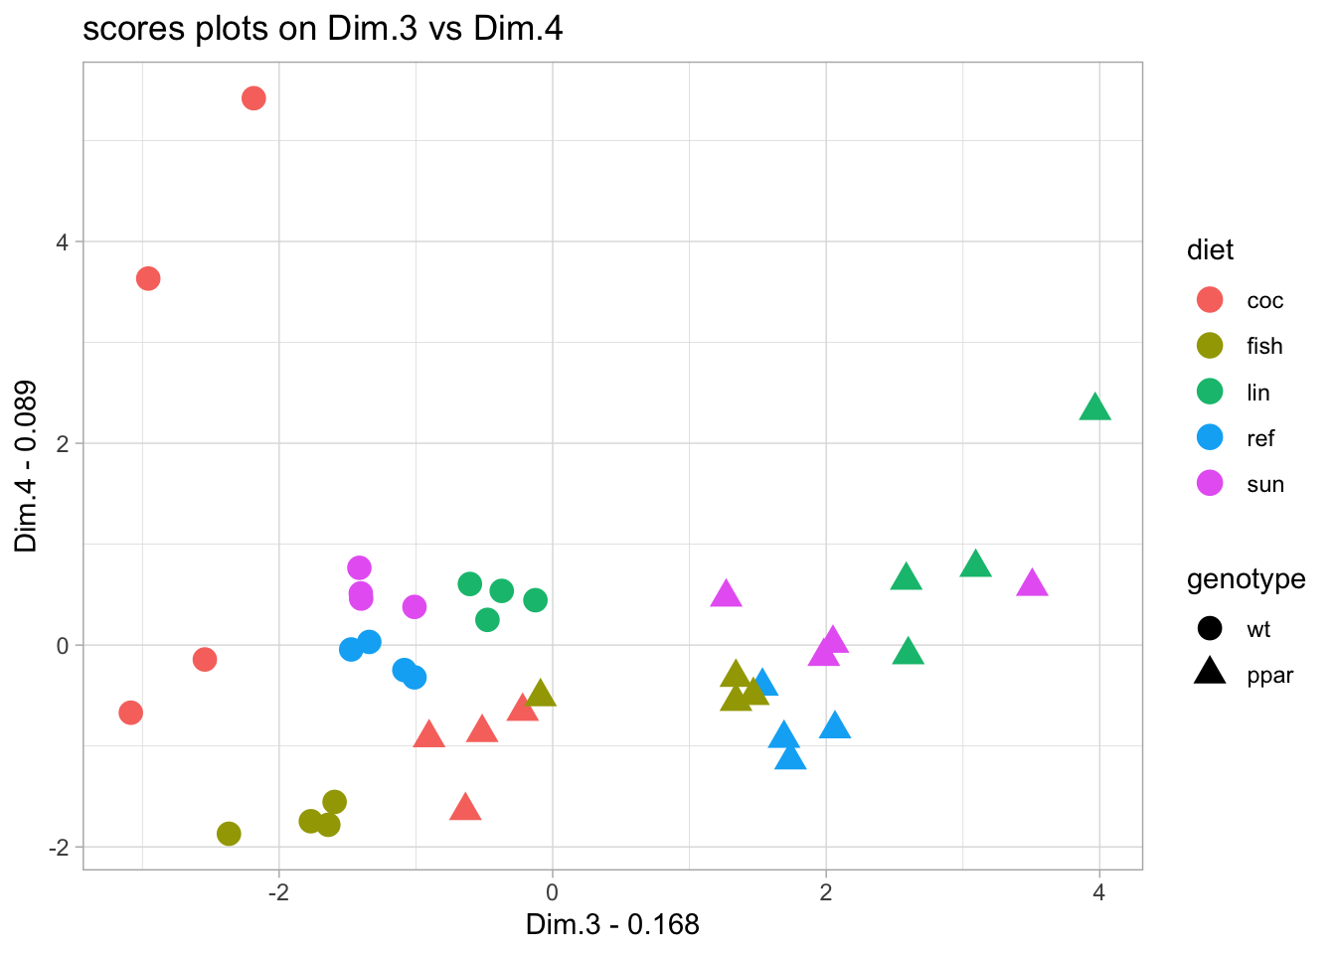
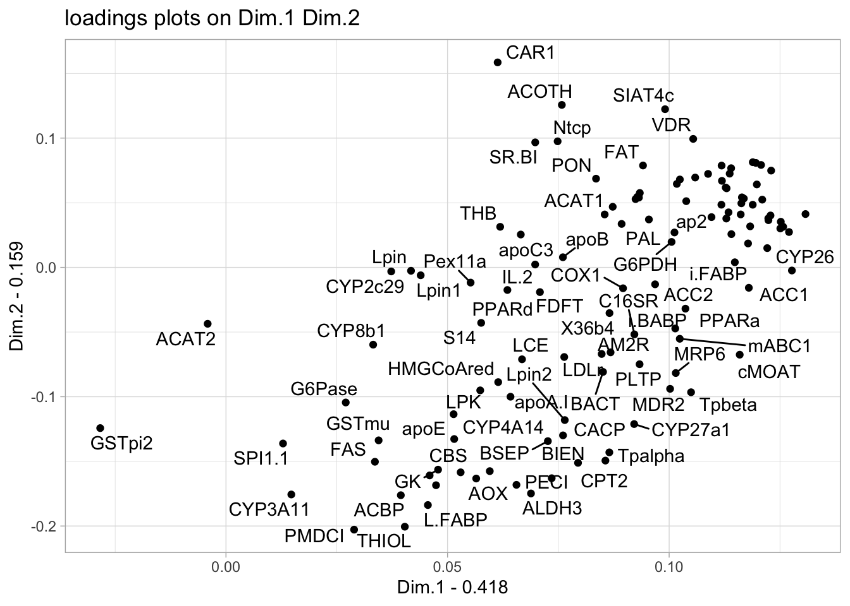
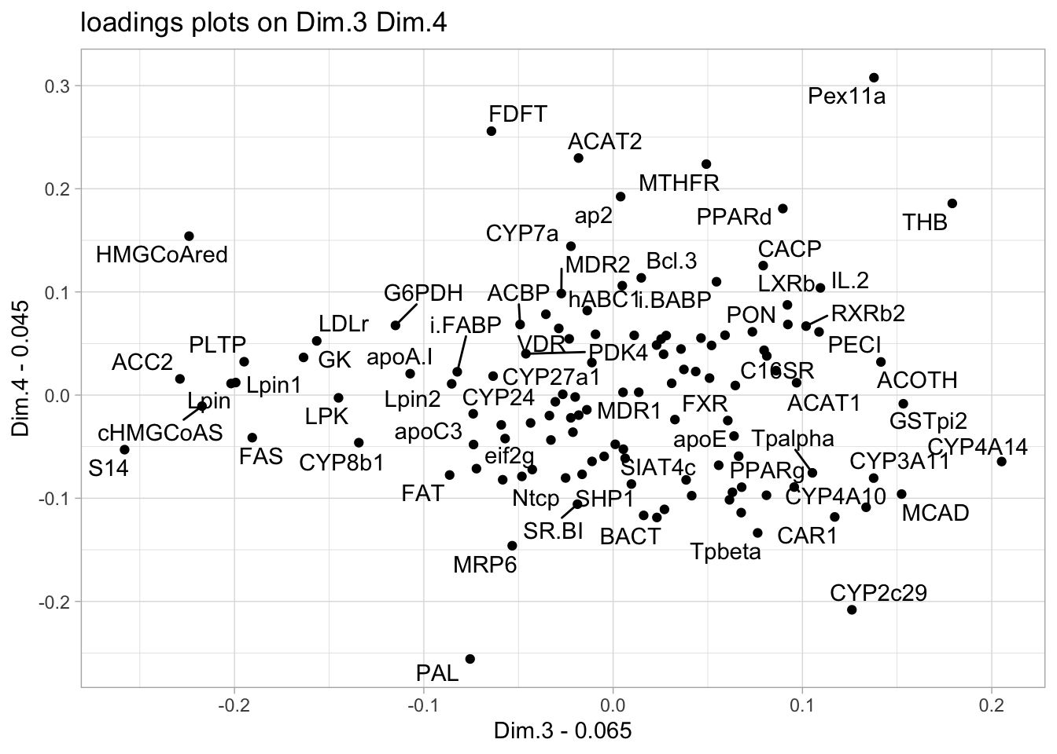
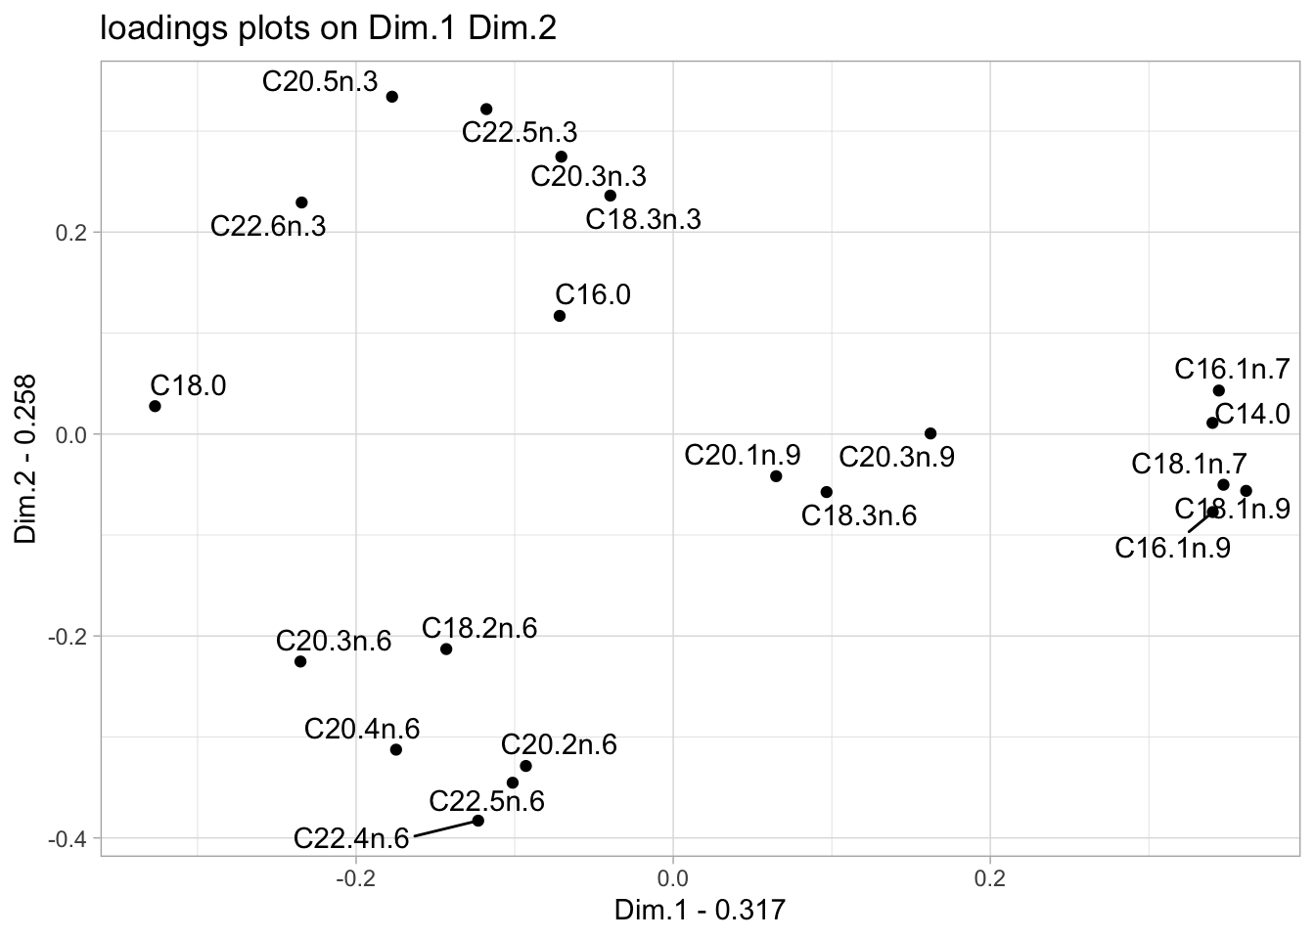
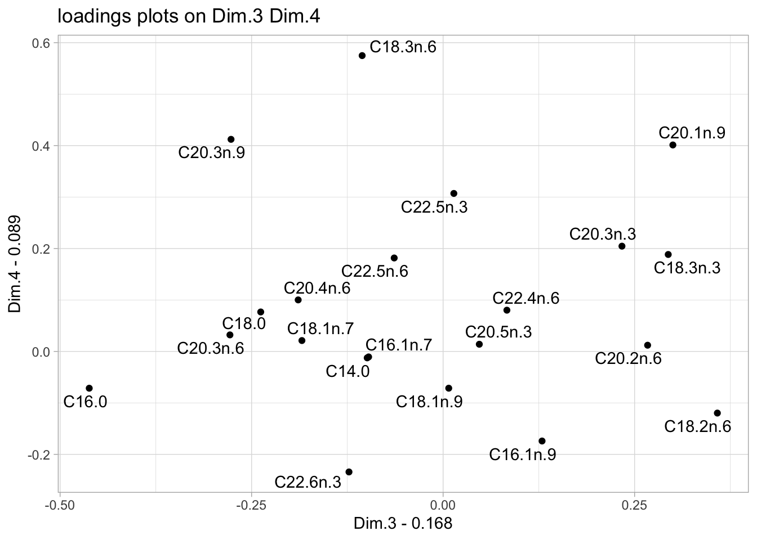
Sample space visualisation and variable contributions
genes
lipids

Slide 7
Principal Component Analysis - summary
Purpose: Reduce the dimensionality of high-dimensional data while preserving as much variance as possible.
How it works: PCA constructs new, orthogonal axes called Principal Components (PCs). These are linear combinations of the original variables.
Key properties:
PCs are ranked by the amount of variance they explain.
PC1 captures the most variance, followed by PC2, and so on.
Each PC is orthogonal to the others.
Why use PCA in omics:
Reveal dominant patterns and trends. What overarching patterns or trends can be observed in the dataset?
Visualize sample clustering. Do the samples group or cluster according to relevant biological?
Identify variables contributing most to variation. Which variables play the most significant role in explaining the observed variation across samples?

Slide 8
PLS between two matrices
Goals:
Explore relationships between genes and lipids
Tasks:
1. PLS Canonical Analysis
Fit a model in canonical mode
Plot scores and loadings for both blocks
2. PLS Regression Analysis
Fit model using mode = "regression”
Plot scores and loadings for both blocks
3. Compare both modes
Compare score plots and interpret differences
library(mixOmics)
pls(…,mode=”canonical")
PLS_res$variates$X and PLS_res$variates$Y
PLS_res$loadings$X and PLS_res$loadings$Y
pls(…,mode="regression")
PLS_res_reg$variates$X and PLS_res_reg$variates$Y

Slide 9
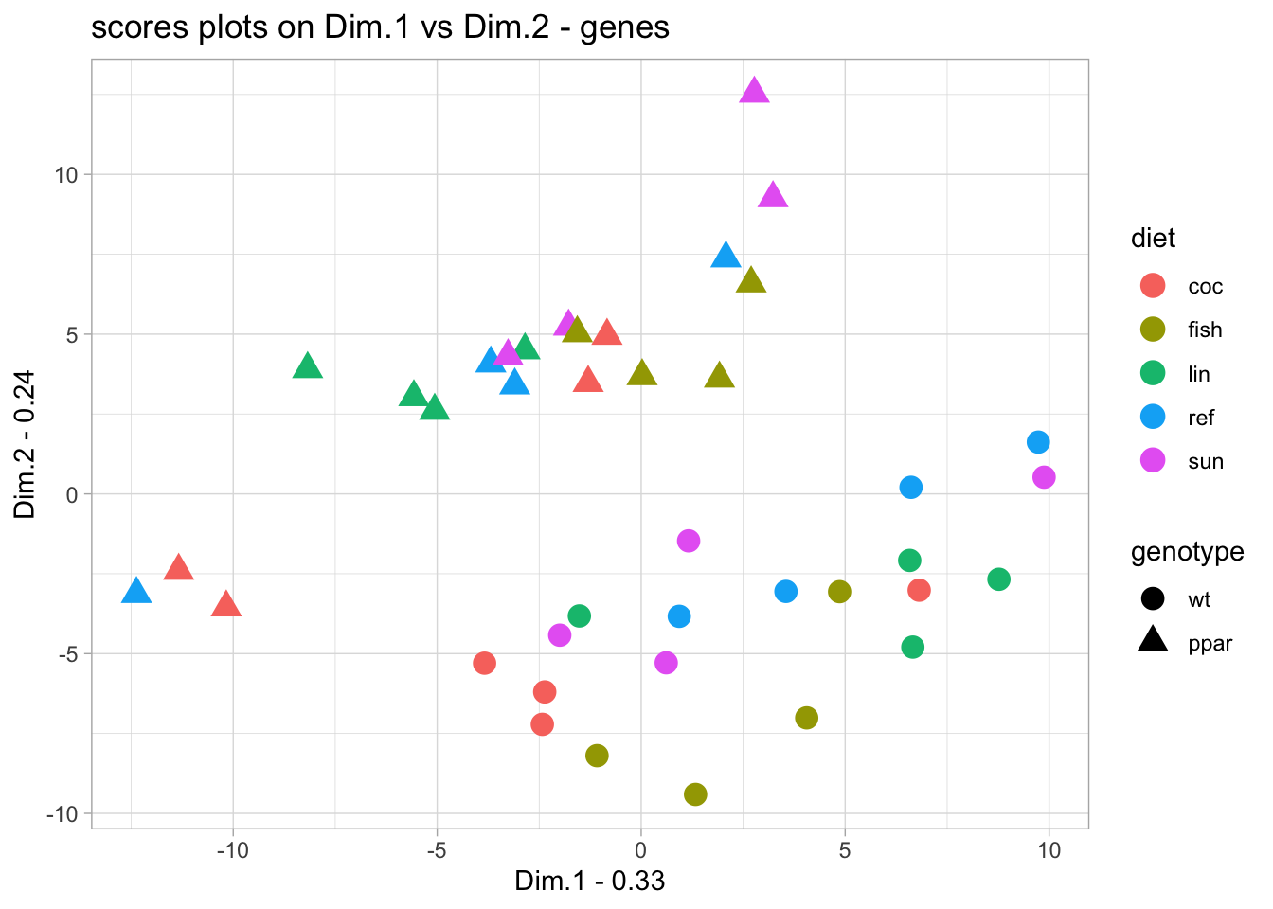
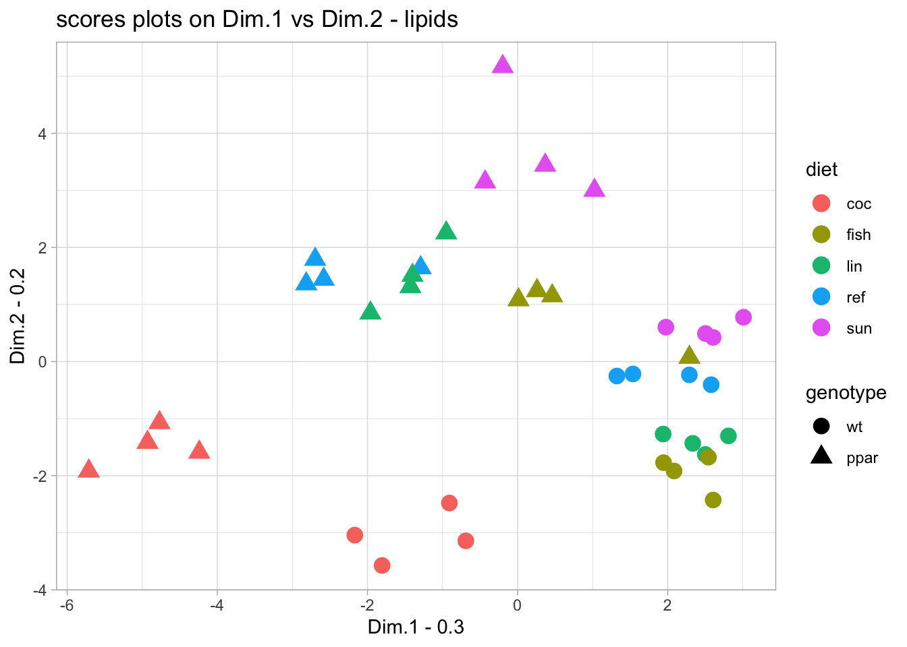
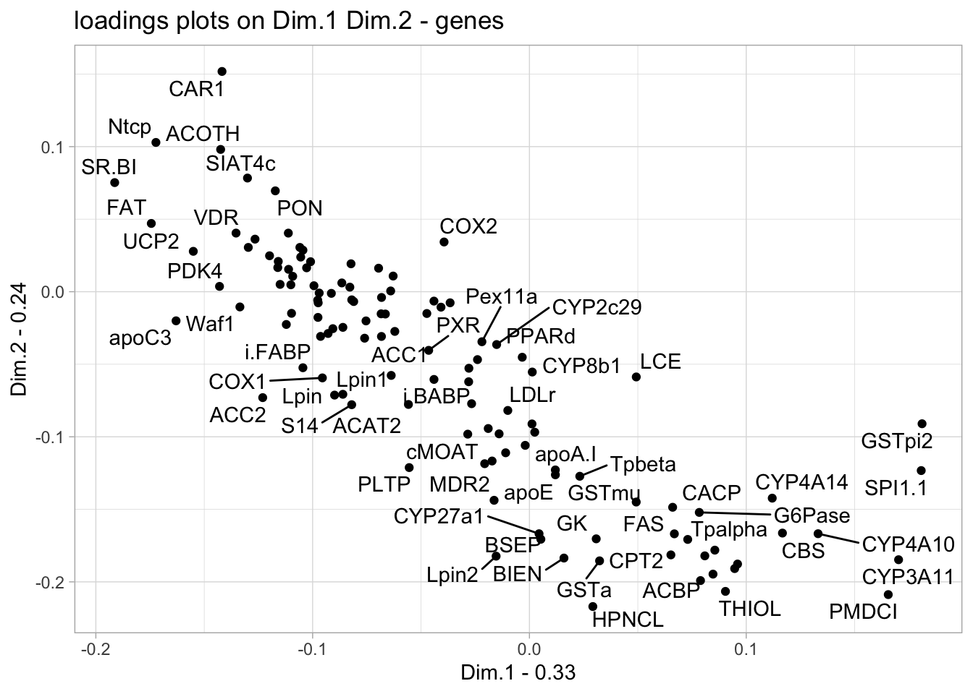
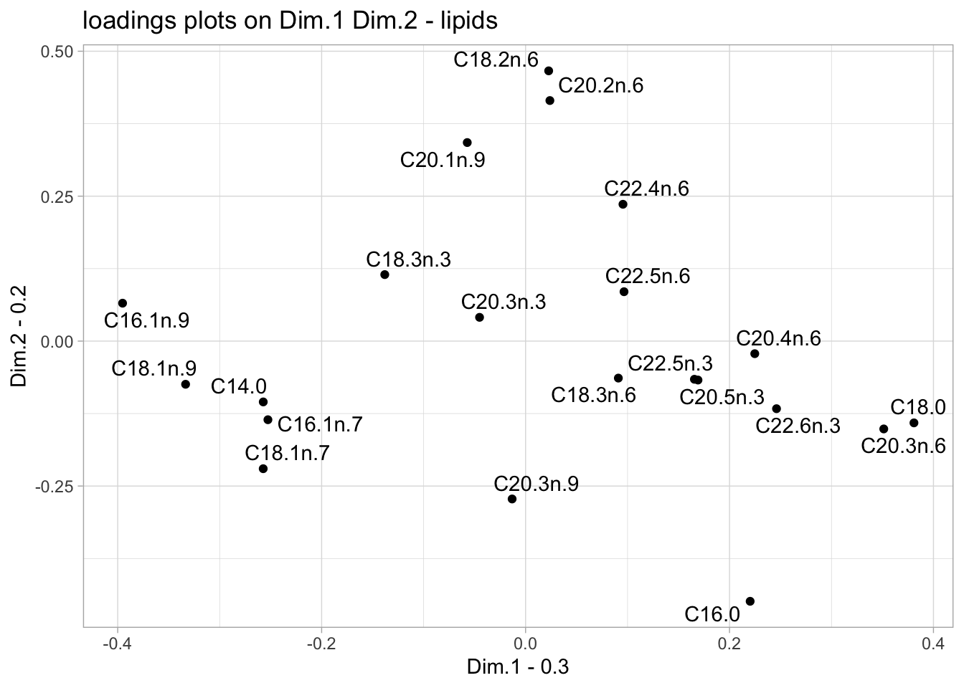
PLS Canonical Analysis
genes
lipids

Slide 10
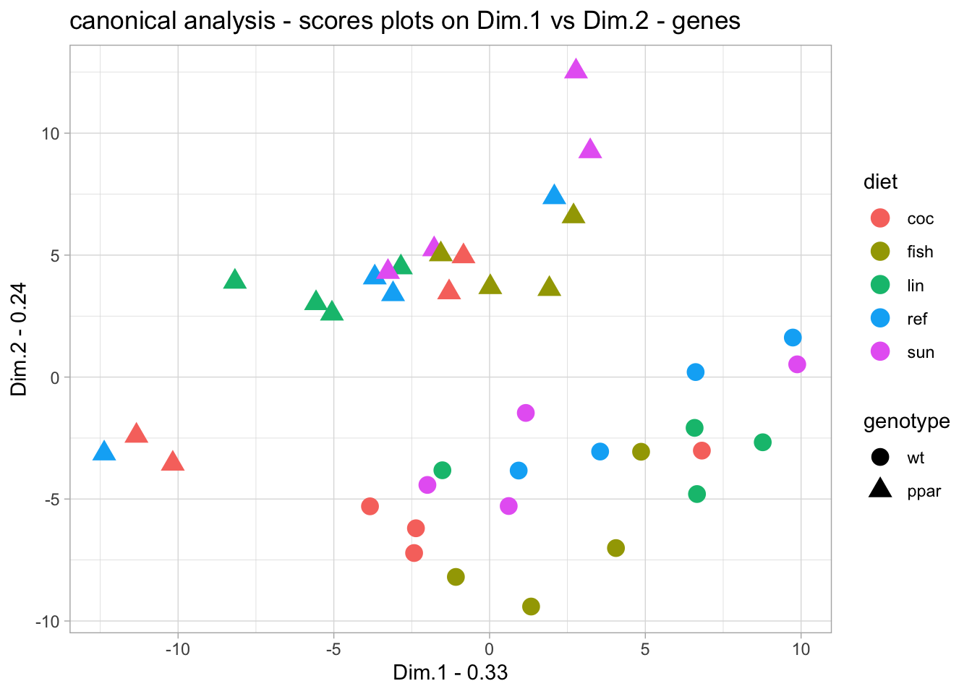
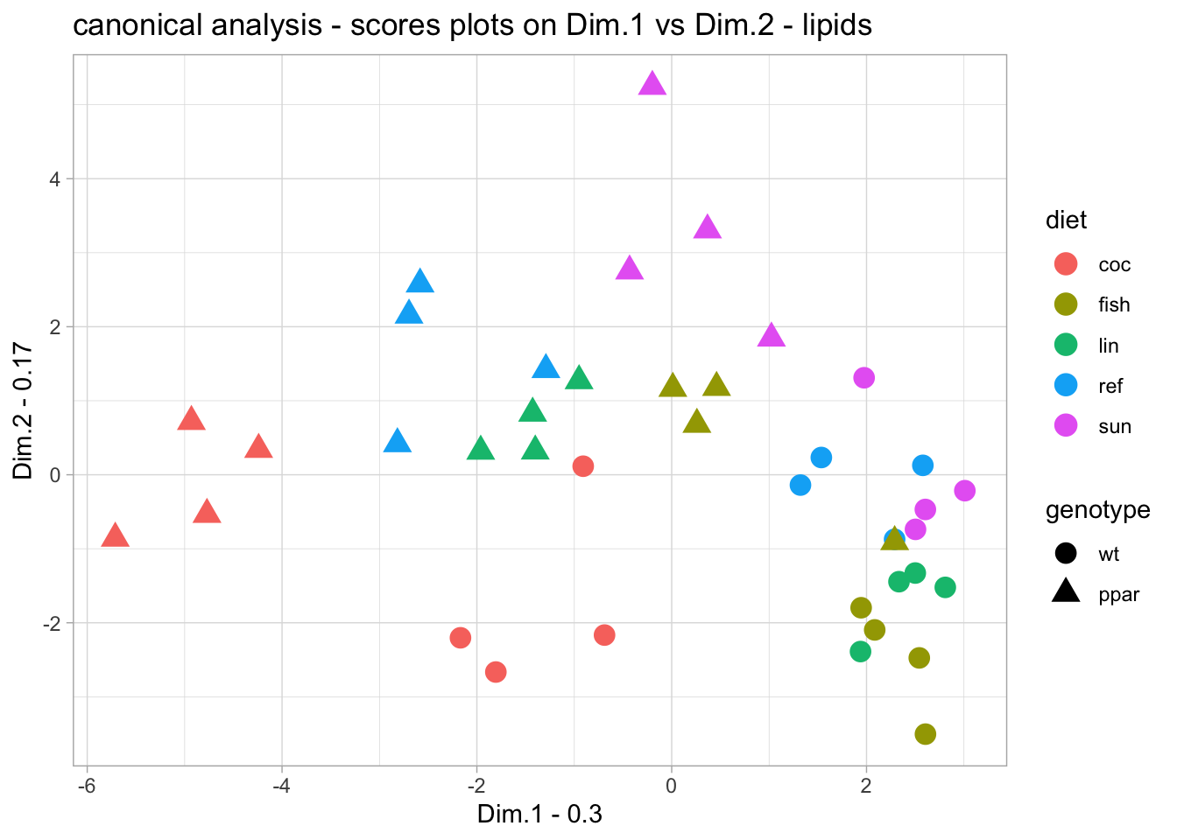
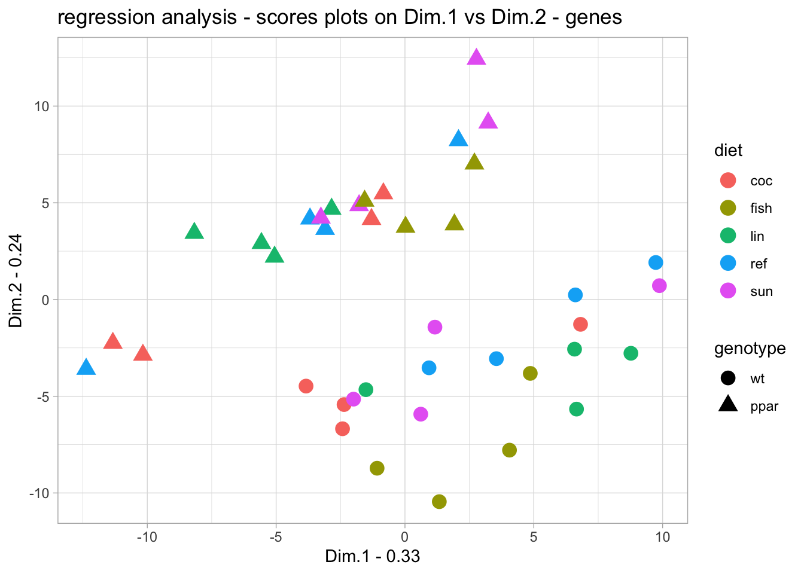
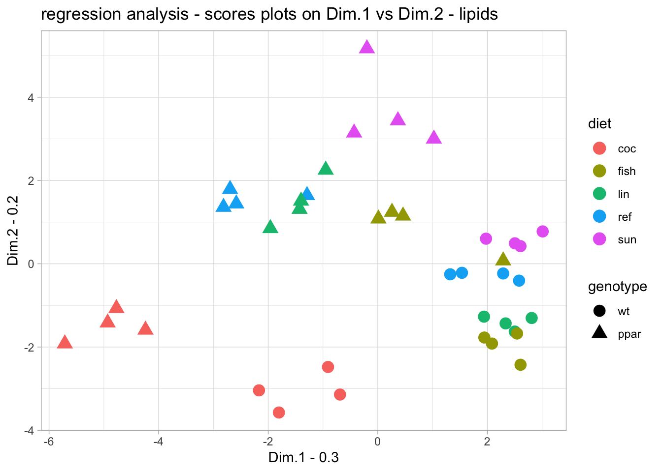
Comparison between PLS in canonical and regression modes
genes (X)
lipids (Y)

Slide 11
Partial Least Square analyses - summary
Purpose: Explore and model relationships between two continuous datasets by identifying latent components that maximize covariance.
How it works: PLS constructs new axes (latent variables) as linear combinations of the original variables from each dataset. These components reduce dimensionality while capturing shared structure between datasets.
Canonical Mode (mode = "canonical")
Symmetric treatment of X and Y
No predefined predictor-response roles
Y is deflated using information from Y
Regression Mode (mode = "regression")
Asymmetric treatment: X = predictors, Y = responses
Fits a linear model from X to Y
Swapping X and Y changes the latent structure
Y is deflated using information from X
Typical questions
Do both datasets reflect biological conditions of interest?
Can Y be modeled effectively using X?
Which subsets of variables are highly correlated and explain shared variation?

Slide 12
PLS discriminant analysis
Goals:
Discriminate genotypes using gene expression
Tasks:
1. PLS-DA Model
Fit model with ropls::opls()
Evaluate with permutation tests (Q², R²Y)
2. Interpretation
Plot scores and loadings
Identify discriminant genes (VIP scores)
library(ropls)
opls(x = nutrimouse$gene,
y = metadata$genotype,
predI = NA,
permI = 100)
PLS_res@modelDF
PLS_res@scoreMN
PLS_res@loadingsMN
PLS_res@vipVn

Slide 13
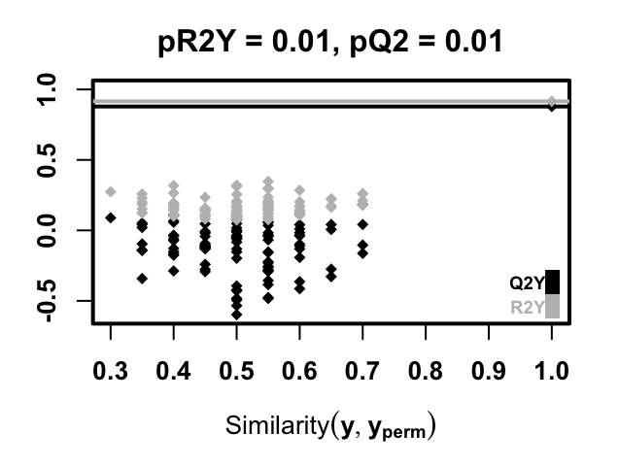
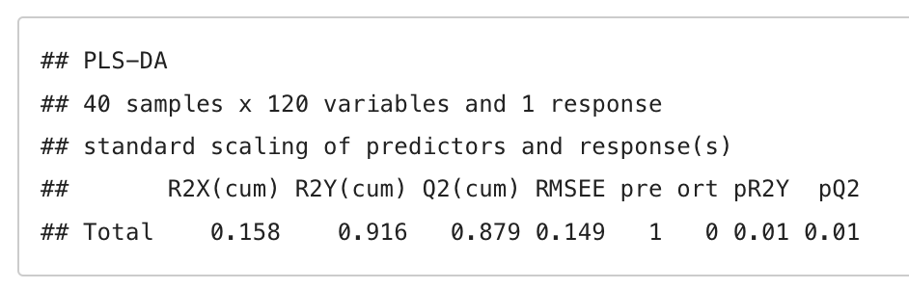
Discriminate genotypes using gene expression
Fit a PLS-DA model with ropls::opls()
Evaluate the model with metrics and permutation tests

Slide 14
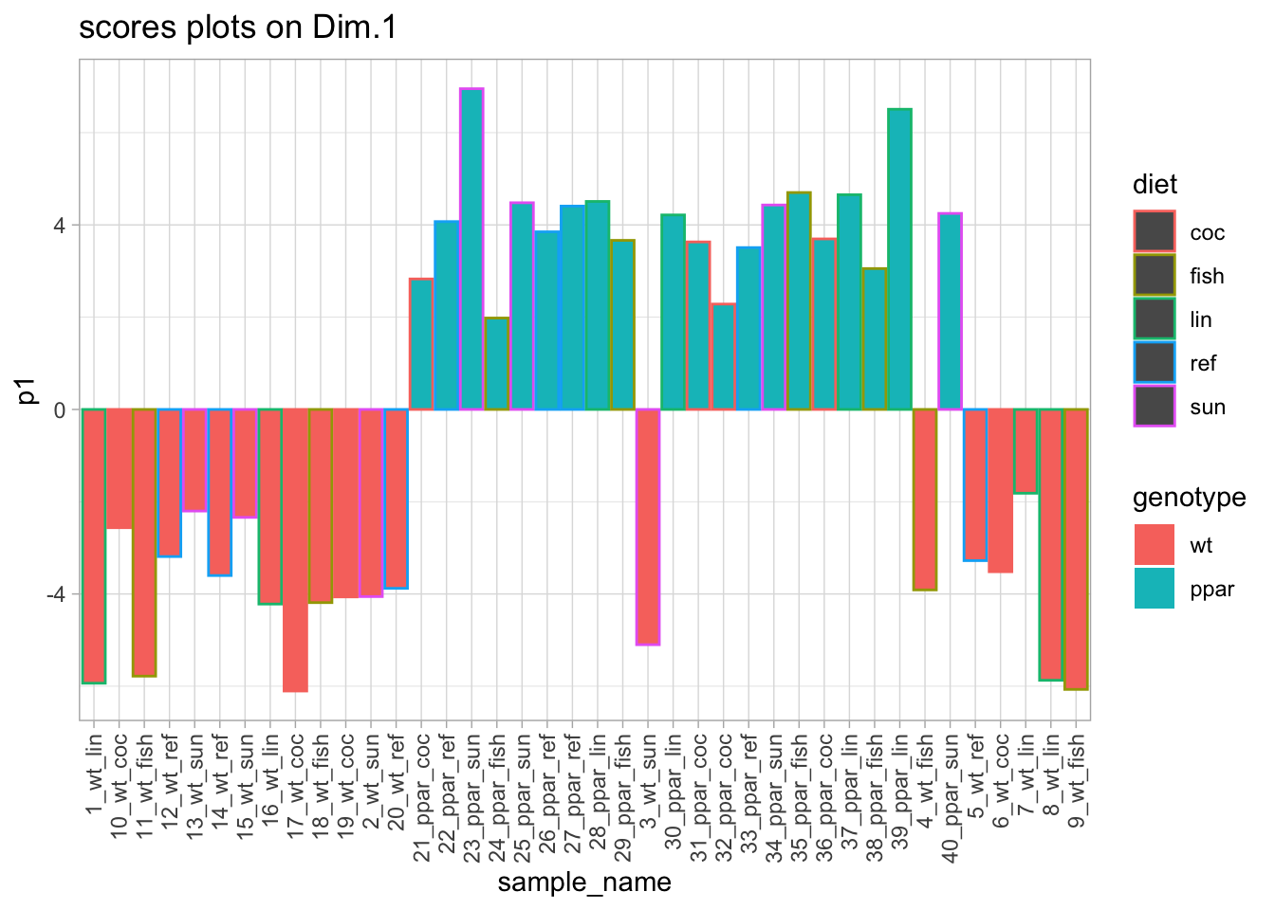
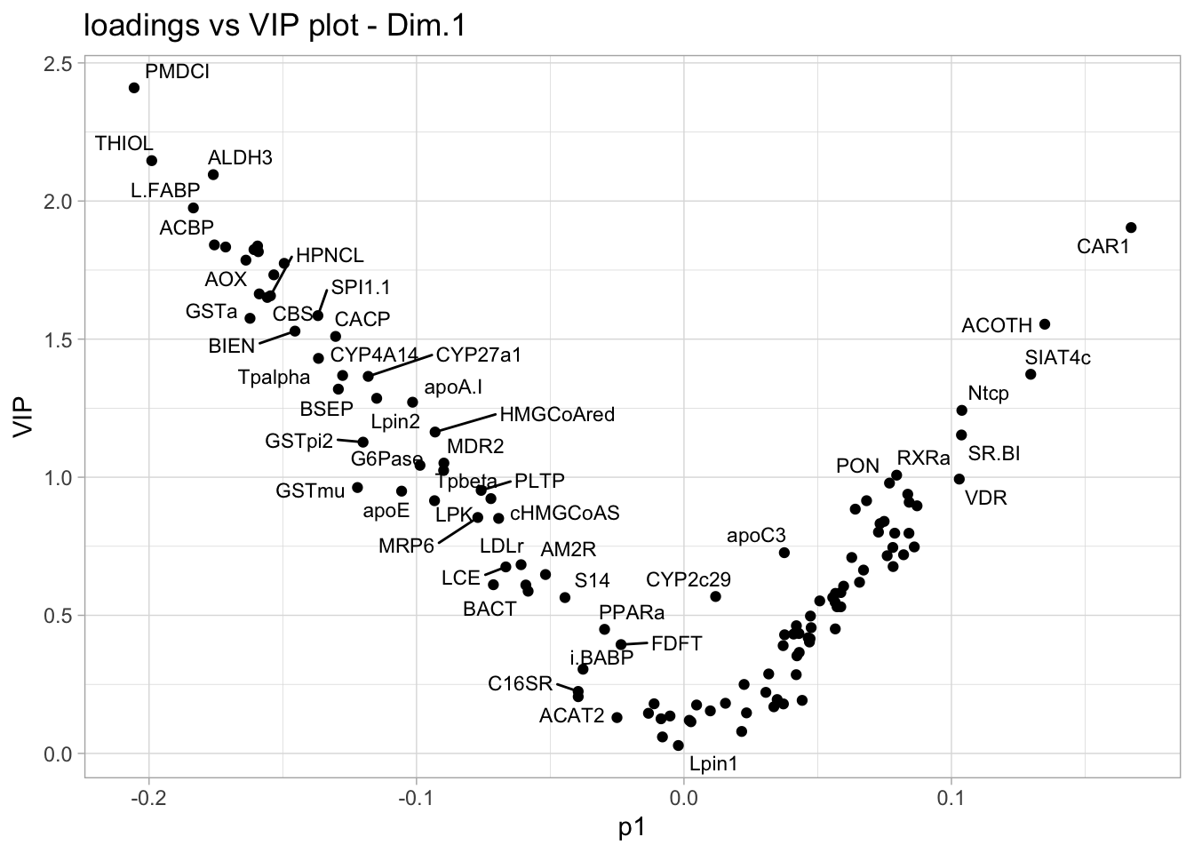
Interpretation

Slide 15
OPLS discriminant analysis
library(ropls)
opls(x = nutrimouse$gene,
y = metadata$genotype,
predI = 1,
orthoI = 1,
permI = 100)
Goals:
Improve interpretability by separating predictive and orthogonal variation
Tasks:
1. OPLS-DA Model
Fit model with ropls::opls()
Evaluate with permutation tests (Q², R²Y)
2. Interpretation
Plot scores and loadings
Identify discriminant genes (VIP scores)
OPLS_res@modelDF
OPLS_res@scoreMN
OPLS_res@orthoScoreMN
OPLS_res@loadingsMN
OPLS_res@orthoLoadingsMN
OPLS_res@vipVn

Slide 16
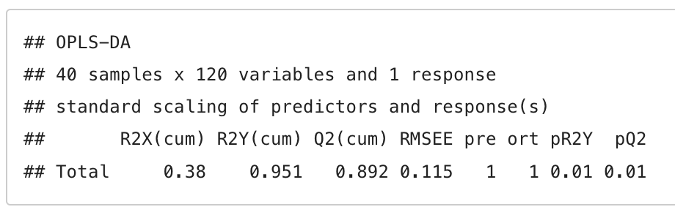
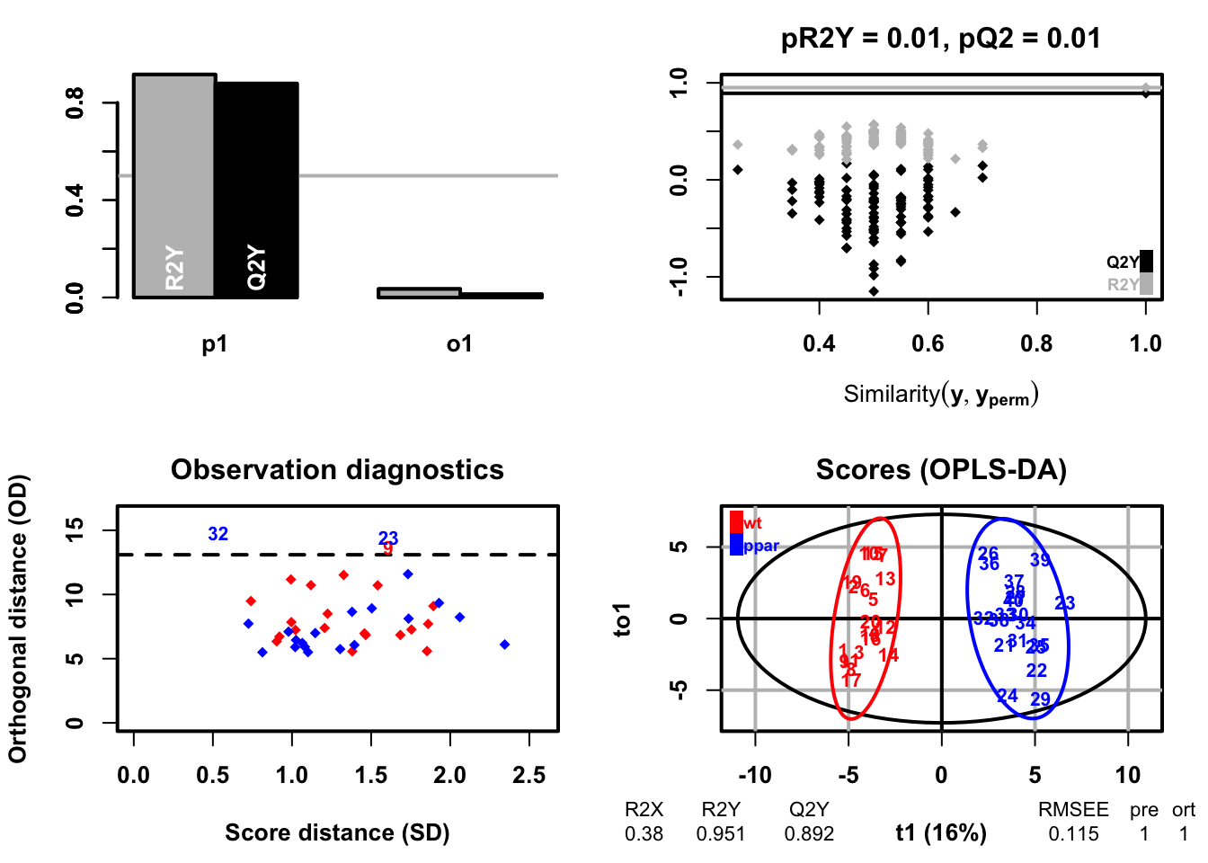
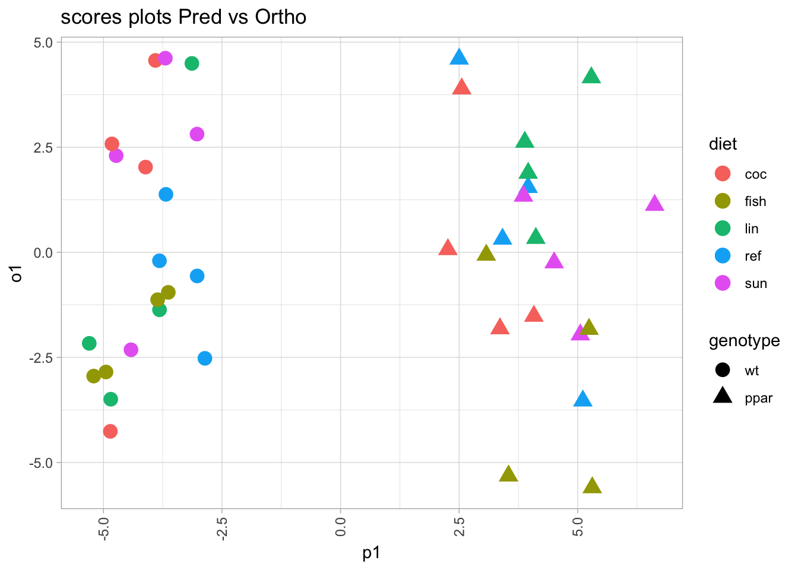
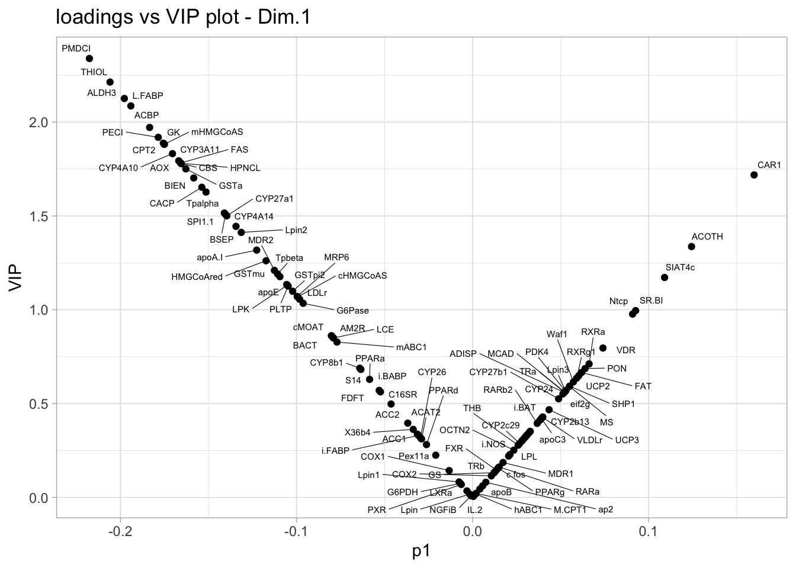
Discriminate genotypes using gene expression

Slide 17
PLS & OPLS discriminant analysis - summary
Purpose
Identify latent components that maximize covariance between predictors and categorical outcomes, enabling sample discrimination and ”biomarker” discovery.
How it works
PLS-DA and OPLS-DA are extensions of PLS regression adapted for classification tasks. They model the relationship between X (predictors) and Y (response), extracting components that best separate outcome groups.
PLS-DA:
Uses all variation in X to model Y
May include noise or irrelevant variation
OPLS-DA:
Separates predictive variation from orthogonal (non-predictive) variation
Improves interpretability and model clarity
Typical Questions
Can we distinguish samples based on their outcome category?
Which variables are most discriminant between outcome groups?
Do these variables form a predictive molecular signature for new samples?

Slide 18
Canonical Correlation Analysis (CCA)
Goals:
Investigate linear relationships between genes and lipids
Tasks:
1. Basic CCA
Use mixOmics::rcc() on 20 genes and all lipids
Plot scores and loadings
2. CCA on scaled data
Repeat with scaled data
Compare results
3. Regularized CCA
Use full gene set
Discuss regularization effects
library(mixomics)
cca.res <- rcc(X=nutrimouse$gene_selected,
Y=nutrimouse$lipid)
cca.res$variates$X
cca.res$variates$Y
cca.res$loadings$X

Slide 19
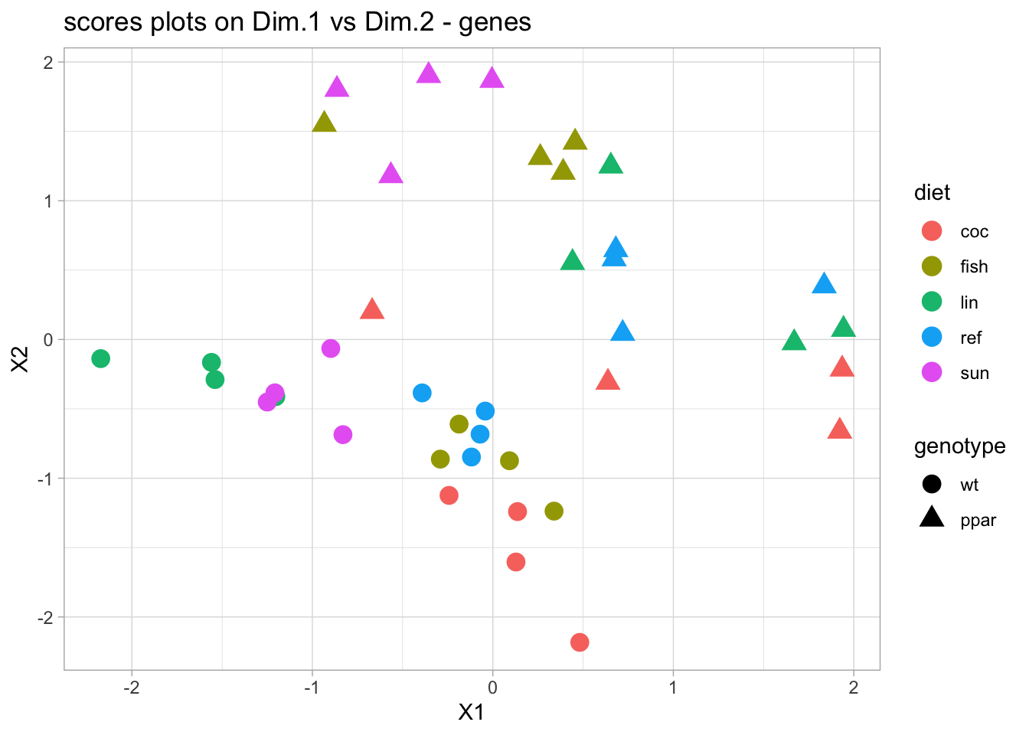

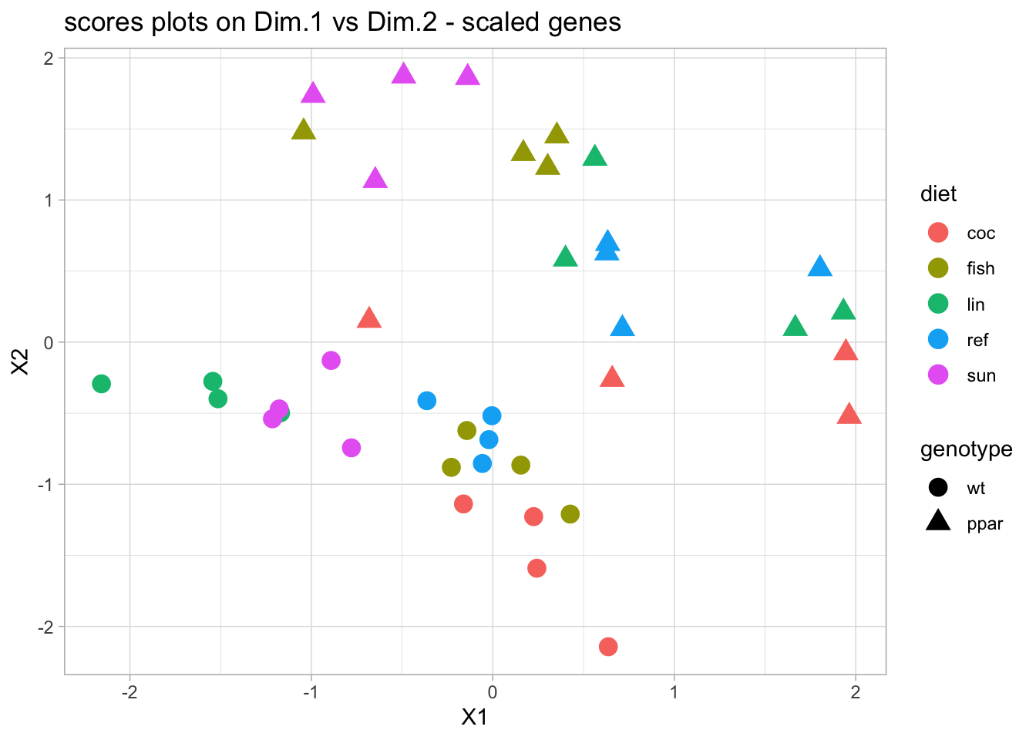
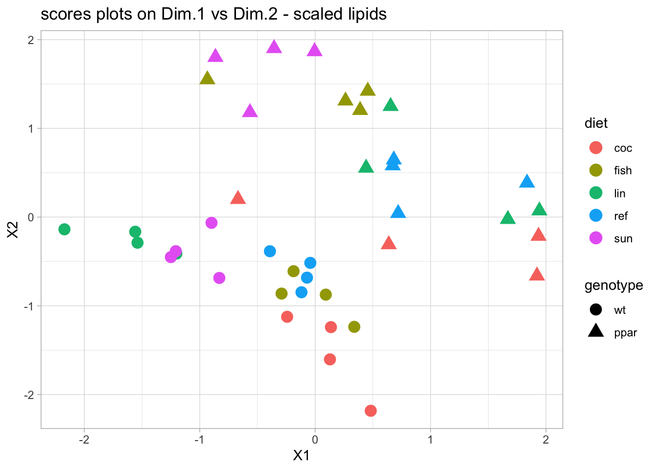
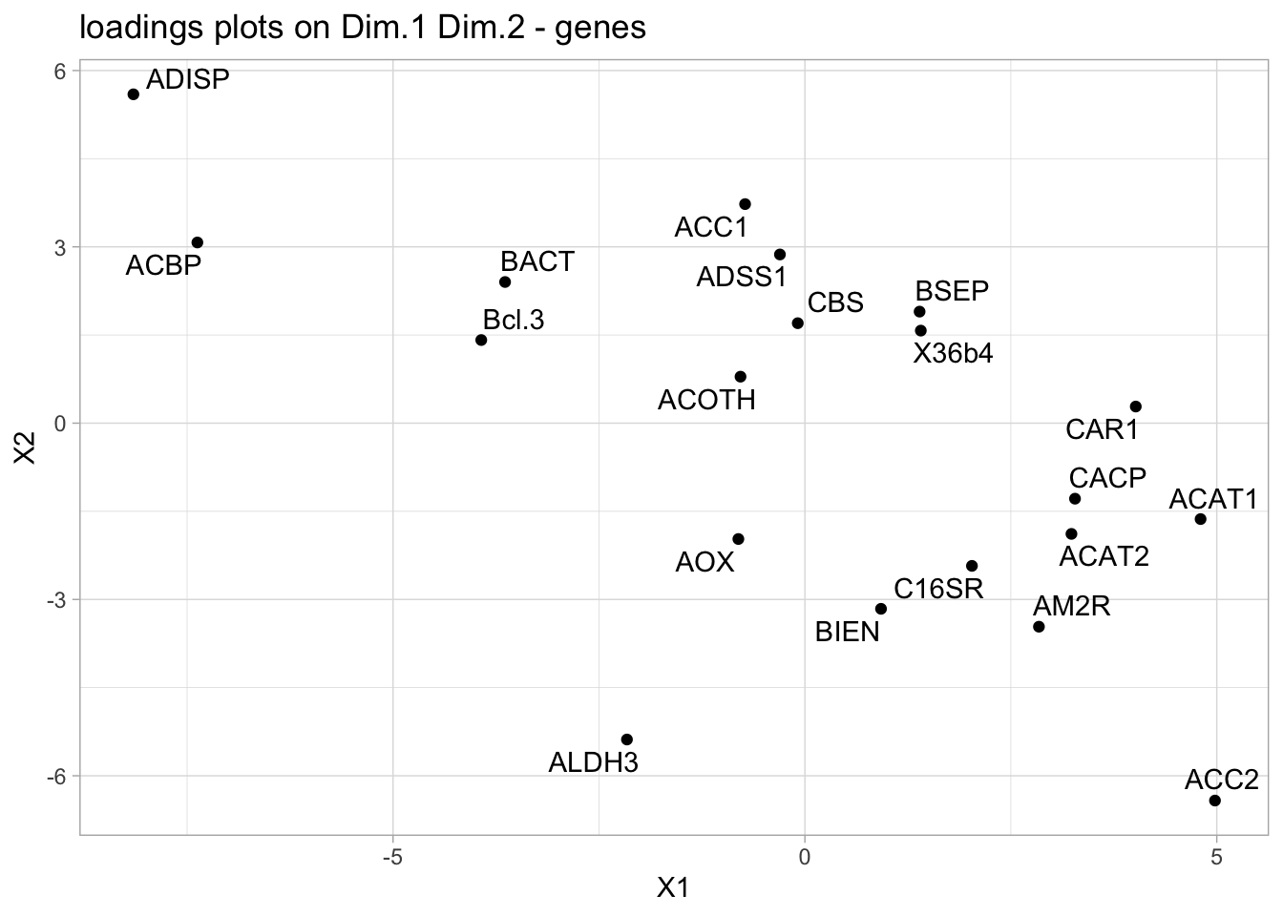
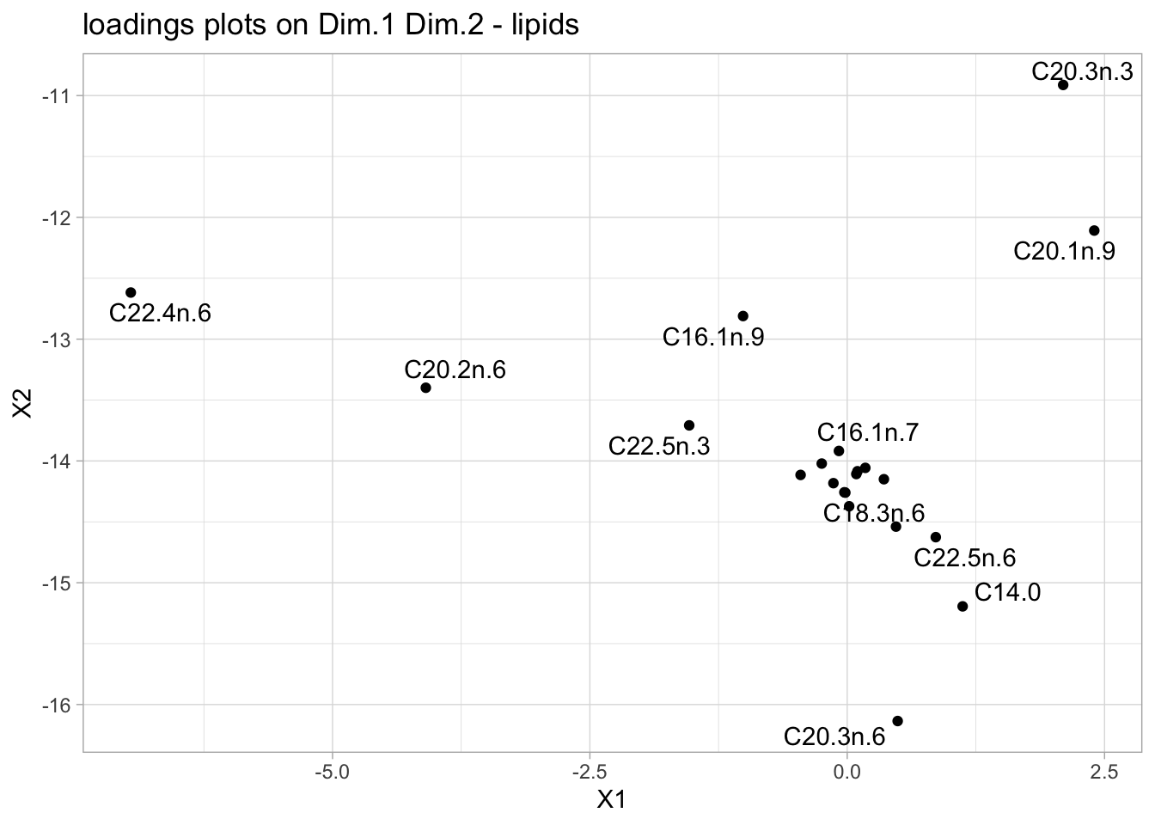
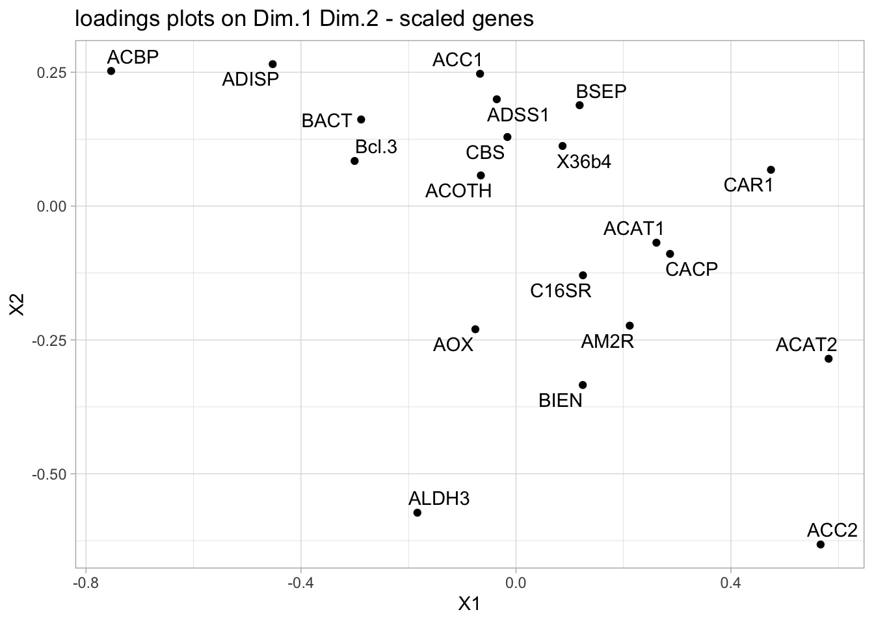
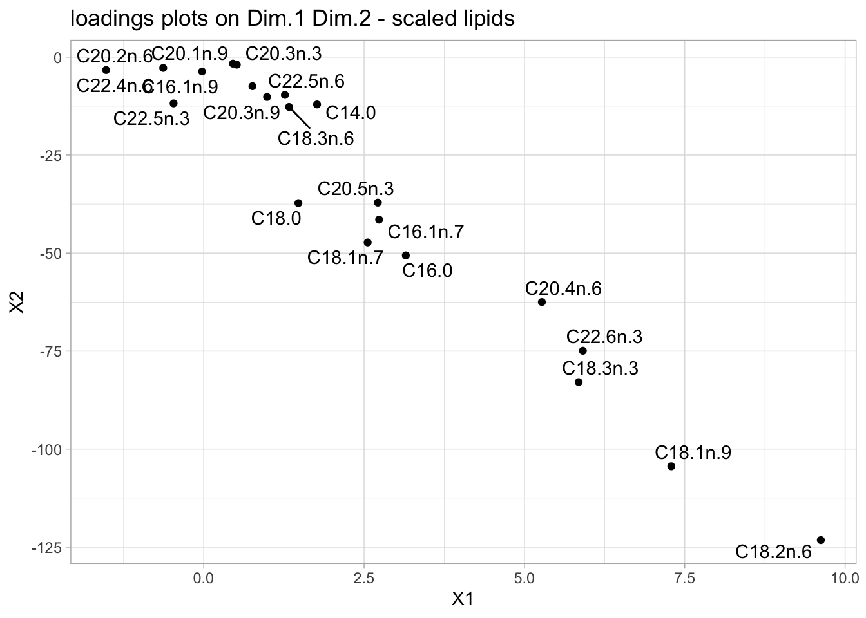
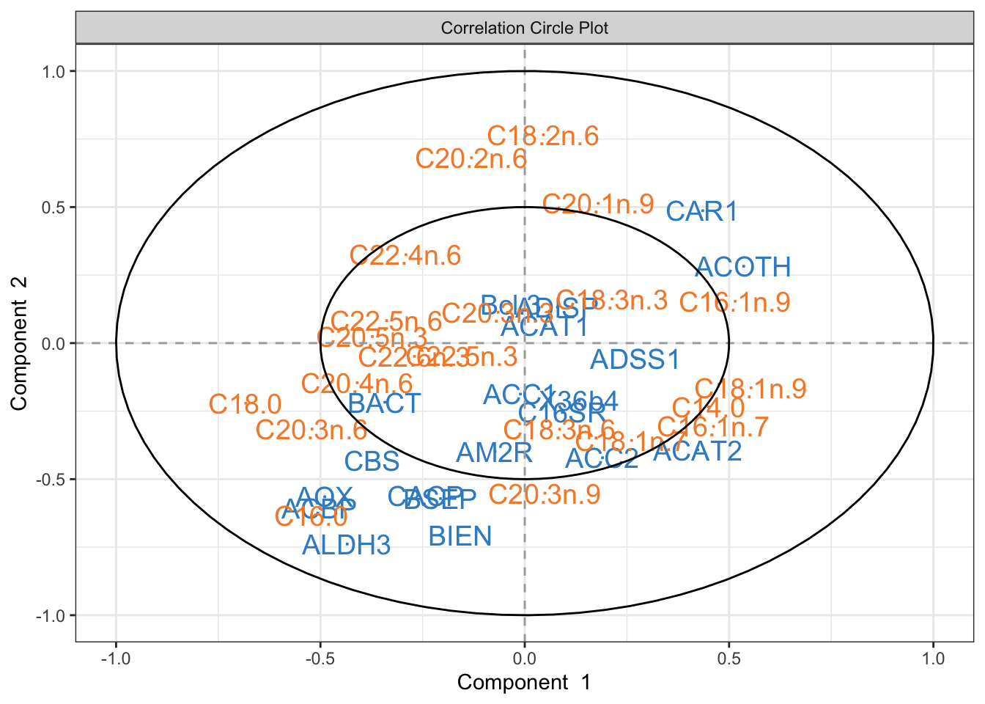
CCA
raw data
scaled
genes (X)
lipids (Y)
genes (X)
lipids (Y)

Slide 20
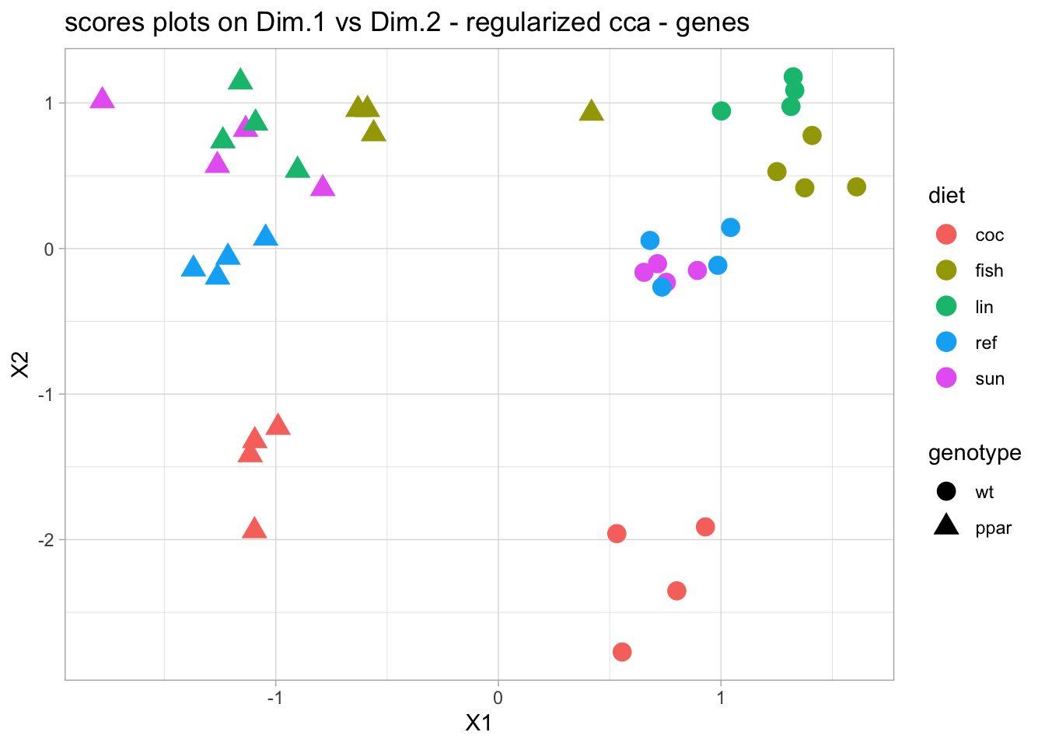
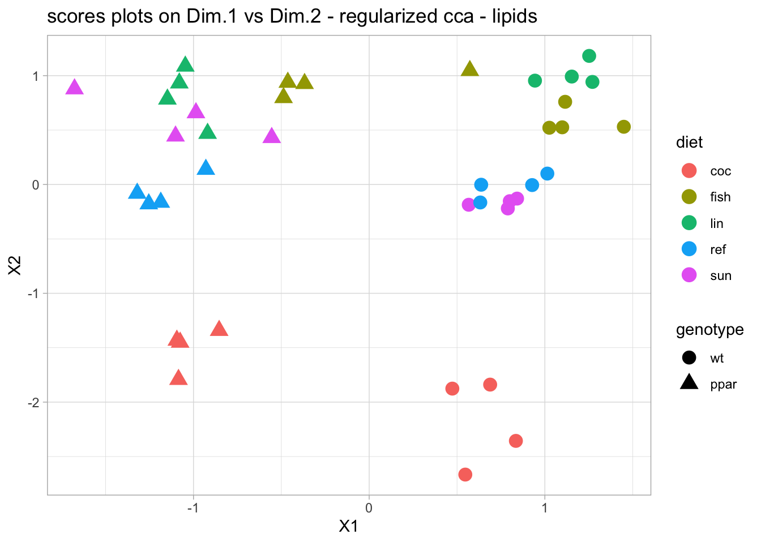
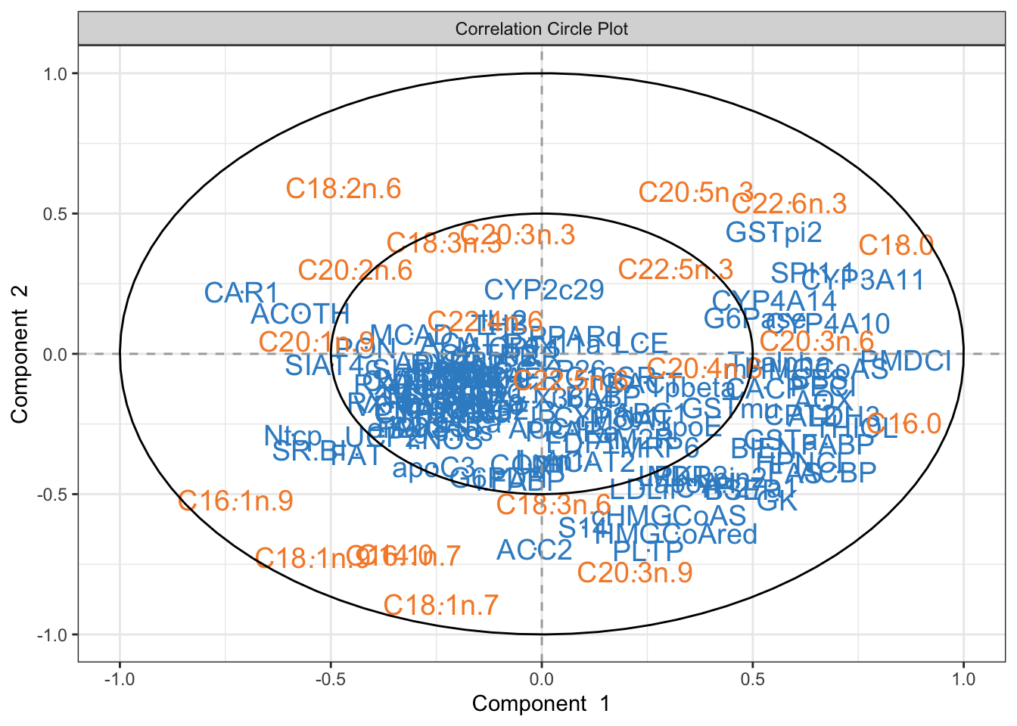
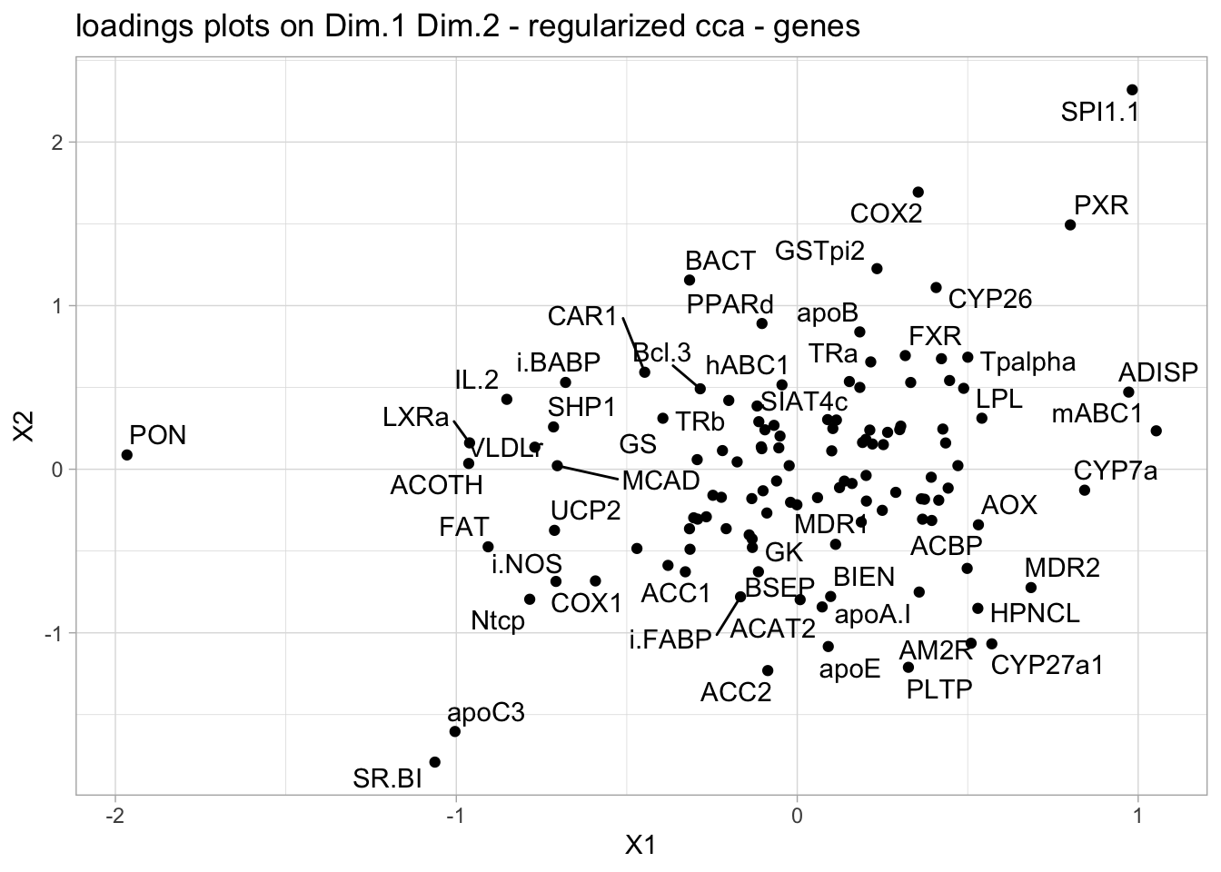
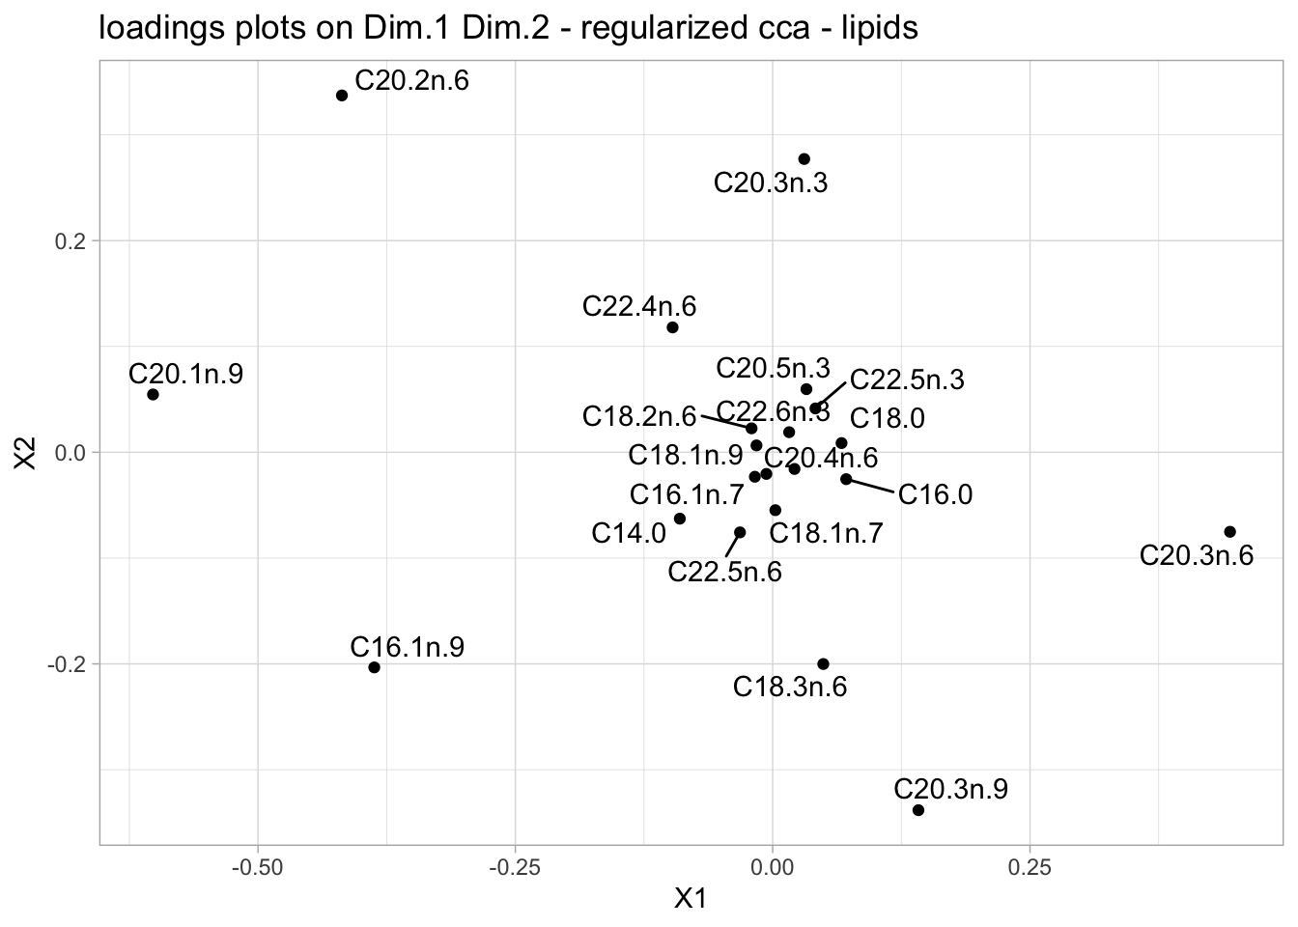
Regularized CCA

Slide 21
CCA - summary
Purpose
Identify linear relationships between two sets of variables, enabling exploration of how changes in one set relate to changes in another, and revealing shared patterns across datasets.
How it works
CCA finds pairs of canonical variables—linear combinations of the original variables from each dataset—that are maximally correlated. It captures shared variation between X and Y, highlighting interdependencies.
Standard CCA: Finds all pairs of canonical variates that maximize correlation, without distinguishing predictive versus non-predictive variation.
Regularized / Sparse CCA: Adds constraints to improve interpretability or handle high-dimensional data, selecting only the most relevant variables.
Typical Questions
How strongly are the two sets of variables related?
Which variables contribute most to the shared patterns?
Can we use these relationships to predict or understand associations between datasets?

Slide 22
Single block analyses - summary
What are the dominant patterns in the data?
Do samples cluster by biological conditions?
Which variables explain the most variation?
PCA
Reduce dimensionality while preserving variance.
CCA
Identify linear relationships between two datasets by maximizing correlation between canonical variables.
Symmetric treatment of X and Y, no predefined roles
Reveals shared patterns and associations between datasets
PLS
Explore and model relationships between two continuous datasets by maximizing covariance.
Canonical Symmetric treatment of X and Y, no predefined roles
Regression Asymmetric: X = predictors, Y = responses, fits linear model from X to Y
PLS-DA & OPLS-DA
Identify latent components that discriminate outcome categories and enable biomarker discovery.
PLS-DA: Uses all variation in X
OPLS-DA: Separates predictive from orthogonal variation for clearer interpretation
How strongly are the two sets of variables related?
Which variables contribute most to the shared patterns?
Can we use these relationships to predict or understand associations between datasets?
Do both datasets reflect biological conditions?
Can Y be modeled using X?
Which variables are highly correlated across datasets?
Can we distinguish samples by outcome?
Which variables are most discriminant?
Do they form a predictive molecular signature?

